Slide 1

The Quest Toward Generality in Natural Language Understanding
Daniel Khashabi
Notes:
Before I start, let me just say that: - It’s an honor to be here; I appreciate this opportunity - excited to share my research with y’all.
If you have any clarification questions, please interrupt me; otherwise, let’s delay open-ended questions till after the talk.
# Alternative titles:
Inching toward generality
Quest toward generality

Slide 2
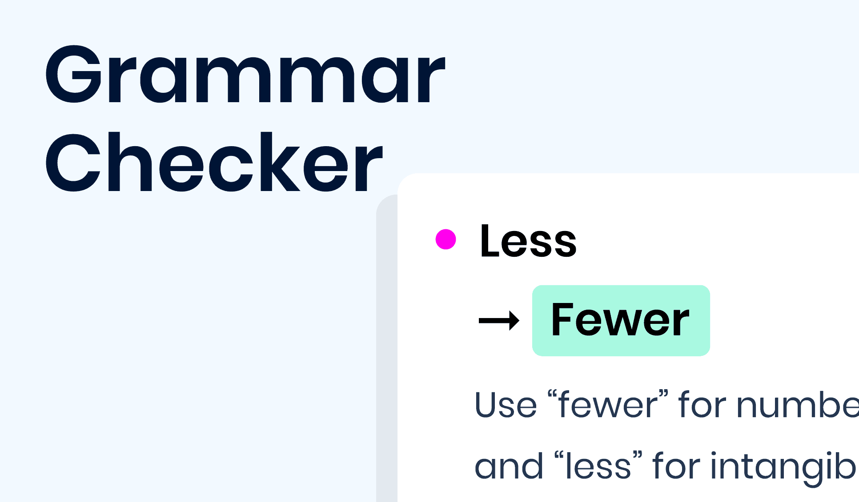

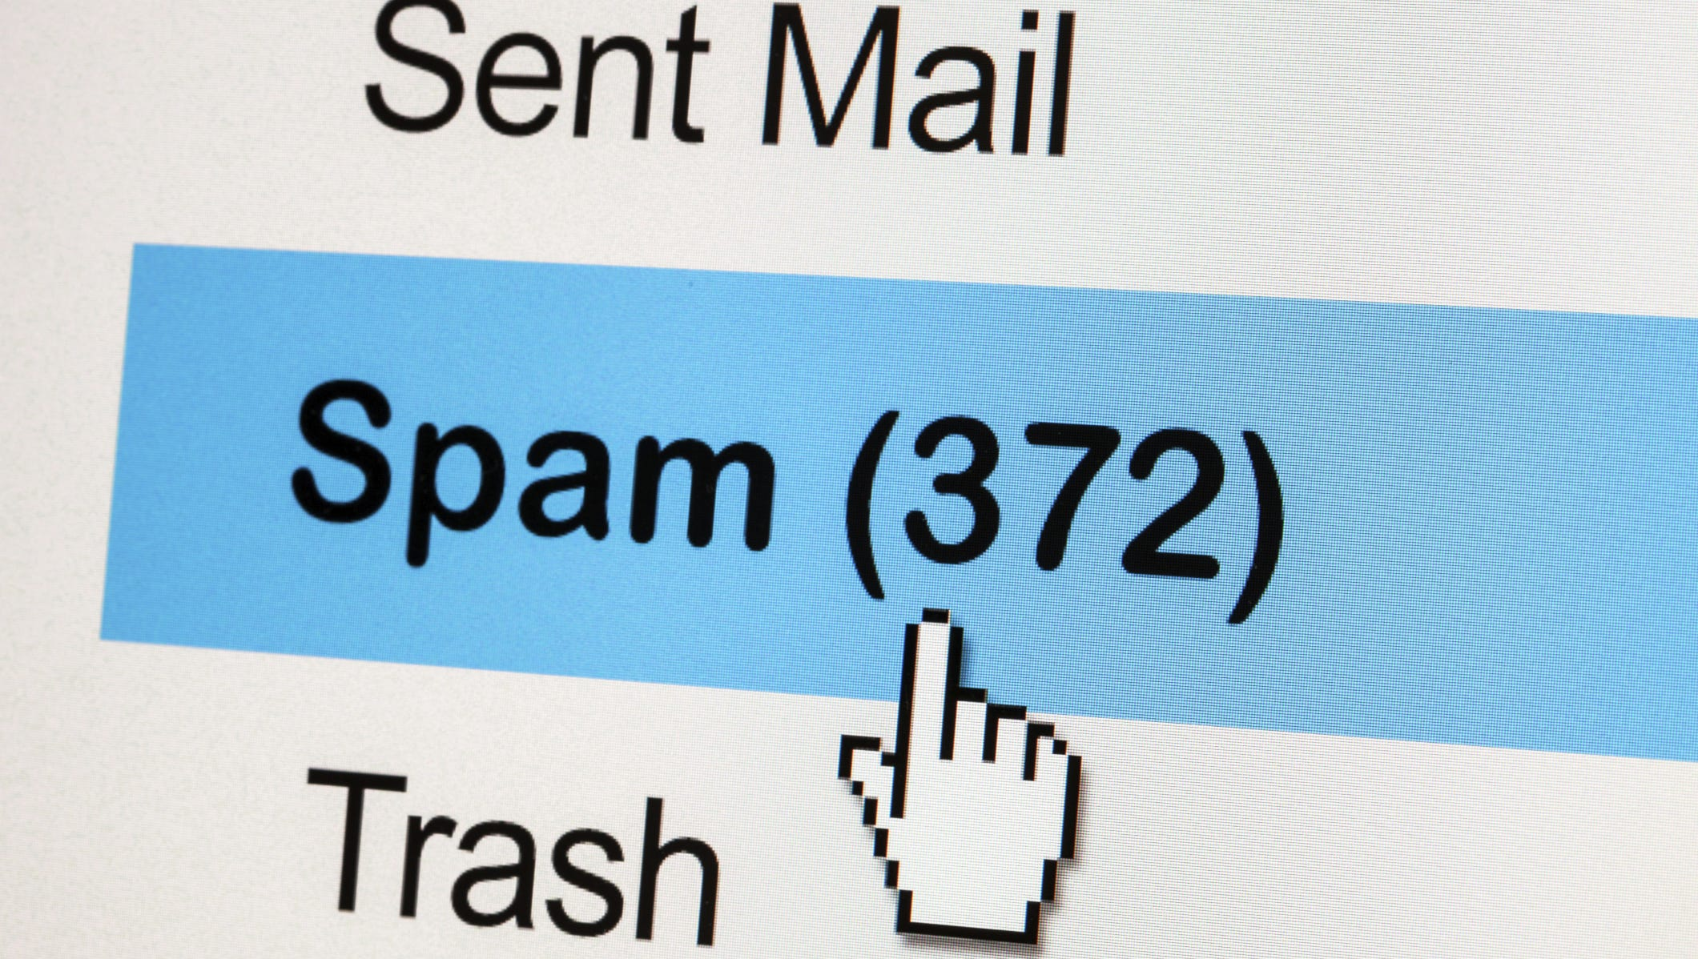
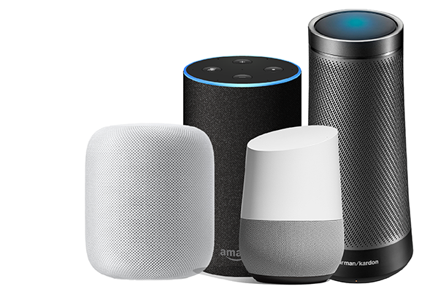
AI-driven Language Interfaces
… are everywhere!
Notes:
Let me start with where we’re today:
Today we’re at a place where we can see AI-driven language interfaces everywhere.
- They translate for us, detect spam emails and improve our writing and do many other tasks.
That’s great! We have come a long way!
Despite all the successful applications, these are isolated instance have a narrow target and have to be engineered for every single application.
which begs the question: why don’t we have a single general system that can solve all these tasks, as opposed to many isolated systems.
My research (including what I am going to present today) aims to address this challenge.
But before I get into my work, I’m going to give you a little context about where are and how we got here.
I am gonna do so, by going back a couple of decades ….
--------
before getting into In order to address this question, I am gonna back a couple of decades

Slide 3
AI-driven Language Interfaces
… are everywhere!
…. have narrow targets!

Slide 4
AI-driven Language Interfaces
… are everywhere!
…. have narrow targets!
Why no single “general” system?

Slide 5
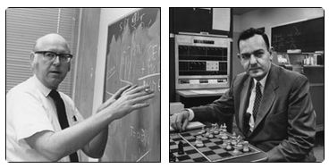
AI’s Inception w/ a Broad Vision
“By ‘general intelligent action’ … a behavior appropriate to the ends of the system and adaptive to the demands of the environment can occur.”
[Newell and Simon, 1959 & 1976]
Notes:
and look at the vision of the early AI researchers
What we see is that they aimed for a quite a broad goal.
As Newell and Simon put it, “general intelligent action” is about showing an appropriate behavior for any given goal in any environment.
Quite a broad vision
You can see this in the naming of their system, “general …”, even though it never became as general as they wished.
Despite such grand visions, the goal of “generality” turned out to be quite difficult ....
What followed was …

Slide 6
AI’s Inception w/ a Broad Vision
“By ‘general intelligent action’ … a behavior appropriate to the ends of the system and adaptive to the demands of the environment can occur.”
General Problem Solver
[Newell and Simon, 1959 & 1976]

Slide 7
The Great Separation
general language understanding
“General language understanding” broken into many narrowed tasks
G
Notes:
What followed was a “great separation” into finer-grained tasks and abilities,
Specifically, within the context of language problems, general language understanding was reduced to studying many smaller sub-tasks.
This happened somewhat forced by the difficulty of the problem, over the course of several decade.
For example, tasks defined for:
… and so on.

Slide 8
The Great Separation
general language understanding
“General language understanding” broken into many narrowed tasks
G
…
… …
T1
T2
T3
tasks
Generalization Hierarchy [Chollet, ‘19]

Slide 9
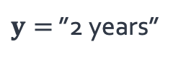

The Great Separation
general language understanding
“General language understanding” broken into many narrowed tasks
G
…
Task: answering questions
T1
$$x=\text{”}\text{How} \text{long} \text{did} ….”$$
$y=$ ”2 years”
… …
T1
T2
T3
tasks
answering questions
Generalization Hierarchy [Chollet, ‘19]

Slide 10

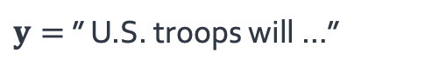

The Great Separation
general language understanding
“General language understanding” broken into many narrowed tasks
G
…
Task: answering questions
T1
$$x=\text{”}\text{How} \text{long} \text{did} ….”$$
$y=$ ”2 years”
… …
T1
T2
T3
tasks
Task: summarizing documents
T2
answering questions
summarizing documents
$$x=$$
$y=$ ” U.S. troops will …”
Generalization Hierarchy [Chollet, ‘19]

Slide 11
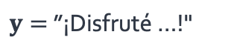

The Great Separation
general language understanding
“General language understanding” broken into many narrowed tasks
G
…
Task: answering questions
T1
$$x=\text{”}\text{How} \text{long} \text{did} ….”$$
$y=$ ”2 years”
… …
T1
T2
T3
tasks
Task: summarizing documents
T2
answering questions
summarizing documents
translating documents
$$x=$$
$y=$ ” U.S. troops will …”
Task: translating documents
T3
$$x=\text{”}\text{Enjoyed} …!\text{”}$$
$y=$ ”¡Disfruté …!"
Generalization Hierarchy [Chollet, ‘19]

Slide 12
The Great Separation
general language understanding
“General language understanding” broken into many narrowed tasks
G
…
Task: answering questions
T1
$$x=\text{”}\text{How} \text{long} \text{did} ….”$$
$y=$ ”2 years”
… …
T1
T2
T3
tasks
Task: summarizing documents
T2
$$x=$$
$y=$ ” U.S. troops will …”
Task: translating documents
T3
$$x=\text{”}\text{Enjoyed} …!\text{”}$$
$y=$ ”¡Disfruté …!"
Generalization Hierarchy [Chollet, ‘19]

Slide 13
The Great Separation
general language understanding
“General language understanding” broken into many narrowed tasks
G
…
Task: answering questions
T1
$$x=\text{”}\text{How} \text{long} \text{did} ….”$$
$y=$ ”2 years”
… …
T1
T2
T3
tasks
Task: summarizing documents
T2
$$x=$$
$y=$ ” U.S. troops will …”
Task: translating documents
T3
$$x=\text{”}\text{Enjoyed} …!\text{”}$$
$y=$ ”¡Disfruté …!"
Generalization Hierarchy [Chollet, ‘19]
Notes:
It didn’t end there,
we kept narrowing down these tasks down in order to make them more tractable.

Slide 14
The Great Separation
general language understanding
“General language understanding” broken into many narrowed tasks
G
…
Task: answering questions
T1
$$x=\text{”}\text{How} \text{long} \text{did} ….”$$
$y=$ ”2 years”
… …
T1
T2
T3
tasks
Task: summarizing documents
…
T2
$$x=$$
$y=$ ” U.S. troops will …”
… …
simpler tasks
T1a
T1b
T1c
Task: translating documents
T3
$$x=\text{”}\text{Enjoyed} …!\text{”}$$
$y=$ ”¡Disfruté …!"
Generalization Hierarchy [Chollet, ‘19]

Slide 15
The Great Separation
general language understanding
“General language understanding” broken into many narrowed tasks
G
…
Task: answering questions
T1
$$x=\text{”}\text{How} \text{long} \text{did} ….”$$
$y=$ ”2 years”
… …
T1
T2
T3
tasks
…
… …
simpler tasks
T1a
T1b
T1c
Generalization Hierarchy [Chollet, ‘19]
Notes:
For example, just the task of answering questions can be studied within different slices of it.
You study questions about simple facts
Simple algebra question
Or elementary school science questions
And so on.
This gave us a variety granularity in how tasks are defined.

Slide 16
The Great Separation
general language understanding
“General language understanding” broken into many narrowed tasks
G
…
Task: answering questions
T1
$$x=\text{”}\text{How} \text{long} \text{did} ….”$$
$y=$ ”2 years”
… …
T1
T2
T3
tasks
answering simple factual questions
…
T1a
… …
simpler tasks
T1a
T1b
T1c
Generalization Hierarchy [Chollet, ‘19]

Slide 17
The Great Separation
general language understanding
“General language understanding” broken into many narrowed tasks
G
…
Task: answering questions
T1
$$x=\text{”}\text{How} \text{long} \text{did} ….”$$
$y=$ ”2 years”
… …
T1
T2
T3
tasks
answering simple factual questions
…
T1a
… …
simpler tasks
answering algebra questions
T1b
T1a
T1b
T1c
Generalization Hierarchy [Chollet, ‘19]

Slide 18
The Great Separation
general language understanding
“General language understanding” broken into many narrowed tasks
G
…
Task: answering questions
T1
$$x=\text{”}\text{How} \text{long} \text{did} ….”$$
$y=$ ”2 years”
… …
T1
T2
T3
tasks
answering simple factual questions
…
T1a
… …
simpler tasks
answering algebra questions
T1b
T1a
T1b
T1c
answering elementary school questions
T1b
…
Generalization Hierarchy [Chollet, ‘19]

Slide 19
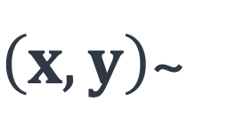
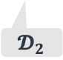
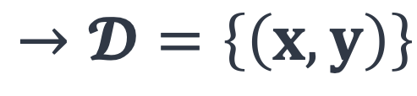
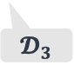
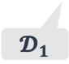
The Dataset Heaven
general language understanding
“General language understanding” broken into many narrowed tasks
Subtasks instantiated as input-output datasets.
G
…
$\left(x, y\right)$~
$$→𝓓=\left\{\left(x, y\right)\right\}$$
… …
T
T1
T2
T3
tasks
…
… …
simpler tasks
T1a
T1b
T1c
$$𝓓_{1}$$
$$𝓓_{2}$$
$$𝓓_{3}$$
Generalization Hierarchy [Chollet, ‘19]
Notes:
And given these tasks, for researchers to study them, they sampled input/output instances from each (often, through crowdsourcing)
Which gave us datasets of input-outputs captured a given task.

Slide 20
Success at Dataset Level
general language understanding
“General language understanding” broken into many narrowed tasks
Subtasks instantiated as input-output datasets.
Statistical models [Brown, Jelinek and others, late 80’s]
Fitting a parameterized model to datasets
G
…
$\left(x, y\right)$~
$$→𝓓=\left\{\left(x, y\right)\right\}$$
… …
T
T1
T2
T3
tasks
…
… …
simpler tasks
T1a
T1b
T1c
$$𝓓_{1}$$
$$𝓓_{2}$$
$$𝓓_{3}$$
Notes:
This coincided with the advent of statistical learning few decades ago, which have led to a lot of progress on individual datasets.
These are essentially parameterized models that are fit to datasets via optimization algorithms.

Slide 21
Success at Dataset Level
general language understanding
Neural Language Models
[Bengio et al. ‘04, Peters et al. ‘18, Raffel et al. ‘20, Brown et al. ’20, …]
G
…
… …
T1
T2
T3
tasks
…
… …
simpler tasks
T1a
T1b
T1c
Statistical models [Brown, Jelinek and others, late 80’s]
Fitting a parameterized model to datasets
$$𝓓_{1}$$
$$𝓓_{2}$$
$$𝓓_{3}$$
Notes:
Most notably, these efforts have given rise to “neural language models”,
that are often implemented as

Slide 22
Success at Dataset Level
general language understanding
Neural Language Models
[Bengio et al. ‘04, Peters et al. ‘18, Raffel et al. ‘20, Brown et al. ’20, …]
G
…
… …
0.2
-0.4
0.1
0.0
-0.5
T1
T2
T3
tasks
Encoder
Decoder
…
… …
simpler tasks
T1a
T1b
T1c
$$𝓓_{1}$$
$$𝓓_{2}$$
$$𝓓_{3}$$
Notes:
… as neural models, with lots of parameters
that encode a given input text into dense representations and decodes them to an output text.
These models are the basis of many recent modeling successes in NLP.
Just as an example, T5 and GPT3 are two notable neural language models I am going to refer to, throughout this talk,
each with billions of parameters,
And by leveraging such statistical architectures, we (the community) have built "data-specific" models, which led to great progress on individual datasets.

Slide 23
Success at Dataset Level
general language understanding
Neural Language Models
[Bengio et al. ‘04, Peters et al. ‘18, Raffel et al. ‘20, Brown et al. ’20, …]
G
…
… …
0.2
-0.4
0.1
0.0
-0.5
T1
T2
T3
tasks
Input
text
Encoder
Decoder
…
… …
simpler tasks
T1a
T1b
T1c
$$𝓓_{1}$$
$$𝓓_{2}$$
$$𝓓_{3}$$

Slide 24
Success at Dataset Level
general language understanding
Neural Language Models
[Bengio et al. ‘04, Peters et al. ‘18, Raffel et al. ‘20, Brown et al. ’20, …]
G
…
… …
0.2
-0.4
0.1
0.0
-0.5
T1
T2
T3
tasks
Input
text
Encoder
Decoder
Output
text
…
… …
simpler tasks
T1a
T1b
T1c
$$𝓓_{1}$$
$$𝓓_{2}$$
$$𝓓_{3}$$

Slide 25


Success at Dataset Level
general language understanding
Neural Language Models
[Bengio et al. ‘04, Peters et al. ‘18, Raffel et al. ‘20, Brown et al. ’20, …]
G
…
… …
0.2
-0.4
0.1
0.0
-0.5
T1
T2
T3
tasks
Input
text
Encoder
Decoder
Output
text
…
… …
simpler tasks
T1a
T1b
T1c
T5
GPT-3
$$𝓓_{1}$$
$$𝓓_{2}$$
$$𝓓_{3}$$

Slide 26

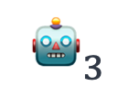
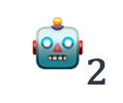
Success at Dataset Level
general language understanding
Neural Language Models
[Bengio et al. ‘04, Peters et al. ‘18, Raffel et al. ‘20, Brown et al. ’20, …]
G
…
… …
0.2
-0.4
0.1
0.0
-0.5
T1
T2
T3
tasks
Input
text
Encoder
Decoder
Output
text
…
… …
simpler tasks
T1a
T1b
T1c
T5
GPT-3
$$𝓓_{1}$$
$$𝓓_{2}$$
$$𝓓_{3}$$
$${\text{🤖}}_{1}$$
$${\text{🤖}}_{2}$$
$${\text{🤖}}_{3}$$
dataset-specific models

Slide 27
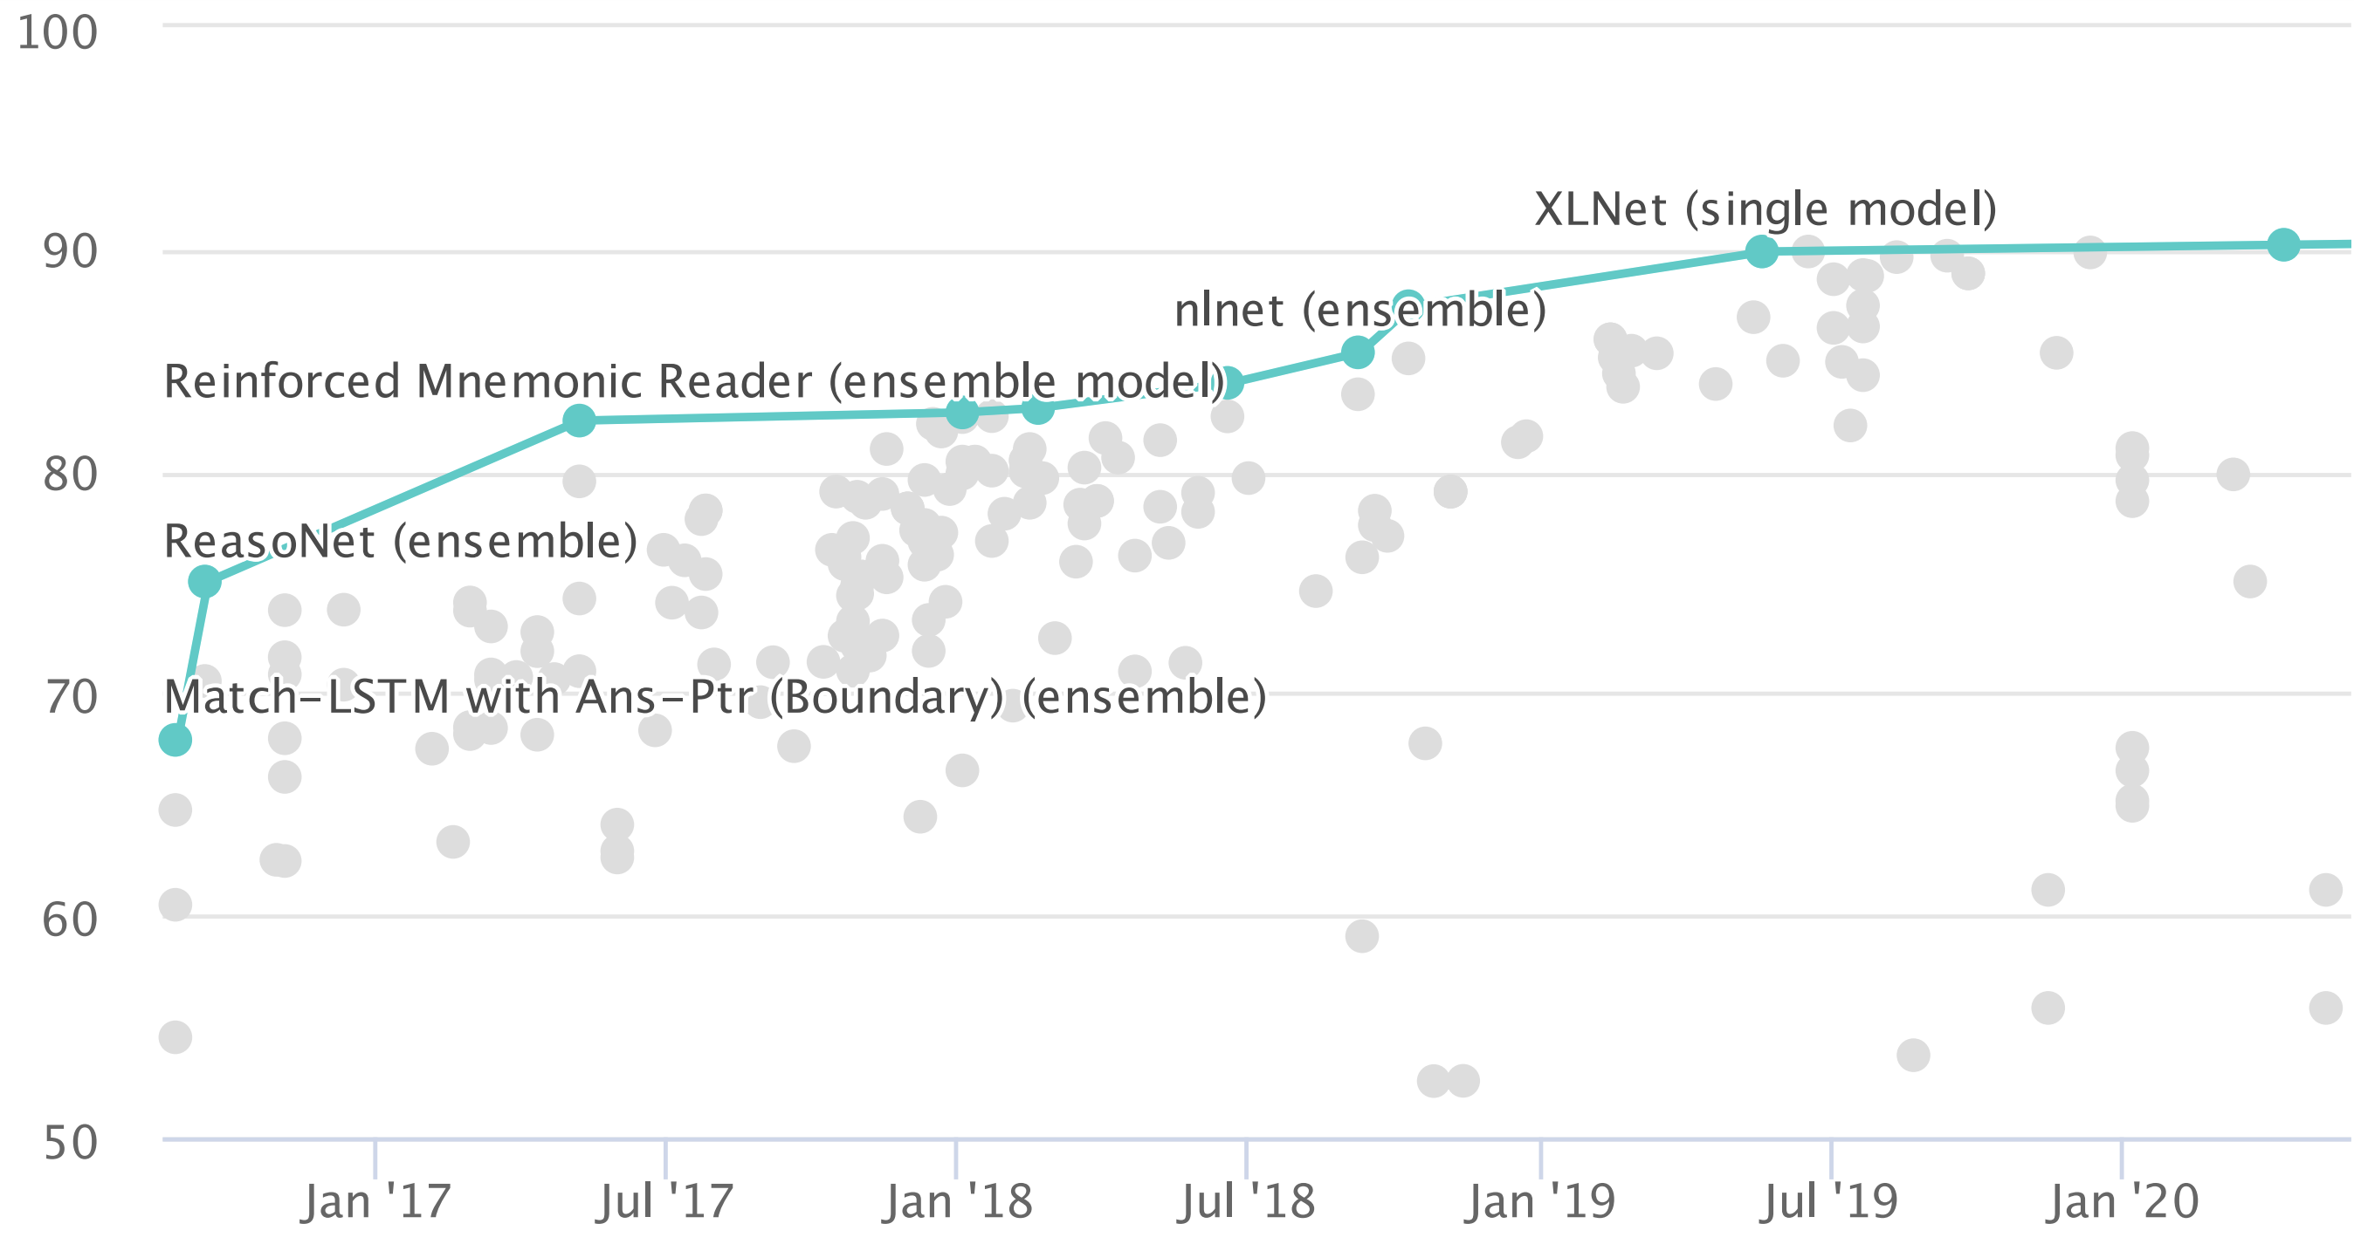
Success at Dataset Level
general language understanding
G
…
Performance (higher is better)
… …
T1
T2
T3
tasks
…
… …
simpler tasks
T1a
T1b
T1c
progress over time on a question answering benchmark [Rajpurkar et al. ‘16]
$$𝓓_{1}$$
$$𝓓_{2}$$
$$𝓓_{3}$$
$${\text{🤖}}_{1}$$
$${\text{🤖}}_{2}$$
$${\text{🤖}}_{3}$$
dataset-specific models
Notes:
On many NLP benchmarks we have witnessed consistent performance improvement, over the course of past years
Just an example, here I am showing the improvements over time, on a question-answering benchmark
→ which was is a great news!

Slide 28
Limits of Success at Dataset Level
general language understanding
G
…
… …
T1
T2
T3
…
… …
T1a
T1b
T1c
$$𝓓_{1}$$
$$𝓓_{2}$$
$$𝓓_{3}$$
$${\text{🤖}}_{1}$$
$${\text{🤖}}_{2}$$
$${\text{🤖}}_{3}$$
dataset-specific models
Notes:
However, none of these advancement resulted in general language understanding.
Essentially, our success on individual datasets was limited to the boundaries of narrowly-defined tasks — “local generalization”.

Slide 29
Limits of Success at Dataset Level
general language understanding
G
Success at dataset level is not enough!
Limited to the scope (local generalization)
…
… …
T1
T2
T3
…
… …
T1a
T1b
T1c
$$𝓓_{1}$$
$$𝓓_{2}$$
$$𝓓_{3}$$
narrow abilities (local generalization)
$${\text{🤖}}_{1}$$
$${\text{🤖}}_{2}$$
$${\text{🤖}}_{3}$$
dataset-specific models

Slide 30
Quest Toward “Generality”
general language understanding
G
Success at dataset level is not enough!
Limited to the scope (local generalization)
…
… …
T1
T2
T3
…
… …
T1a
T1b
T1c
Notes:
On other hand, the quest toward generality requires us to cover more area of this hierarchy,
by building models that capture a broader range of abilities.
Now, this is quite an open-ended target.
And part of the challenge here involves better defining of what it means to progress toward “generality”.
In my focus, on particular throughout my work, I have thought about it along two dimensions:
the breadth of the “generalization hierarchy” ---- which is about building models that …
the depth of the “generalization hierarchy” ---- building models that …
Which also how my talk is organized today.
--------
# And this kind of progress has unfortunately been very hard to achieve, despite the fact that this has one of the main goals of AI since the beginning.
# This necessitates approaches that don’t relying on labeled datasets.
# If AI was just a finite set of tasks and datasets, we could have just trained a model to imitate it.

Slide 31
Quest Toward “Generality”
general language understanding
G
Success at dataset level is not enough!
Limited to the scope (local generalization)
“Generality” necessitates models that capture broader range of abilities.
…
… …
T1
T2
T3
…
… …
T1a
T1b
T1c

Slide 32
Quest Toward “Generality”
general language understanding
G
Success at dataset level is not enough!
Limited to the scope (local generalization)
“Generality” necessitates models that capture broader range of abilities.
Progress on:
…
… …
T1
T2
T3
…
… …
T1a
T1b
T1c

Slide 33
Quest Toward “Generality”
general language understanding
G
Success at dataset level is not enough!
Limited to the scope (local generalization)
“Generality” necessitates models that capture broader range of abilities.
Progress on:
“breadth” — diverse abilities.
…
… …
T1
T2
T3
…
… …
T1a
T1b
T1c

Slide 34
Quest Toward “Generality”
general language understanding
G
Success at dataset level is not enough!
Limited to the scope (local generalization)
“Generality” necessitates models that capture broader range of abilities.
Progress on:
“breadth” — diverse abilities.
“depth” — complex abilities.
…
… …
T1
T2
T3
…
… …
T1a
T1b
T1c

Slide 35
Quest Toward “Generality”
general language understanding
G
Success at dataset level is not enough!
Limited to the scope (local generalization)
“Generality” necessitates models that capture broader range of abilities.
Progress on:
“breadth” — diverse abilities.
“depth” — complex abilities.
…
… …
T1
T2
T3
…
First part
… …
T1a
T1b
T1c
Second part

Slide 36

Research Goal
general language understanding
Long-term goal: more general natural language processing (NLP) systems through unified algorithms and theories.
G
…
… …
T1
T2
T3
…
… …
T1a
T1b
T1c
$$\text{🤖}$$
Notes:
Broadly, the long-term goal of my research is centered around
make natural language processing (NLP) systems more general

Slide 37

Research Goal
general language understanding
Long-term goal: more general natural language processing (NLP) systems through unified algorithms and theories.
G
…
… …
T1
T2
T3
…
… …
T1a
T1b
T1c
$$\text{🤖}$$
Notes:
make natural language processing (NLP) systems more general
by developing unified algorithms and theories

Slide 38
Research Goal
Long-term goal: more general natural language processing (NLP) systems through unified algorithms and theories.
Notes:
This is important, because
In the coming years, language-driven assistants are increasingly present in our life,
and for them to seamlessly augment and improve our experience, they to be versatile and generalize to a variety of tasks and scenarios.
# Other than being intellectually interesting problems, this goal will translate to real impact is real meaningful impacts on real applications of AI:

Slide 39
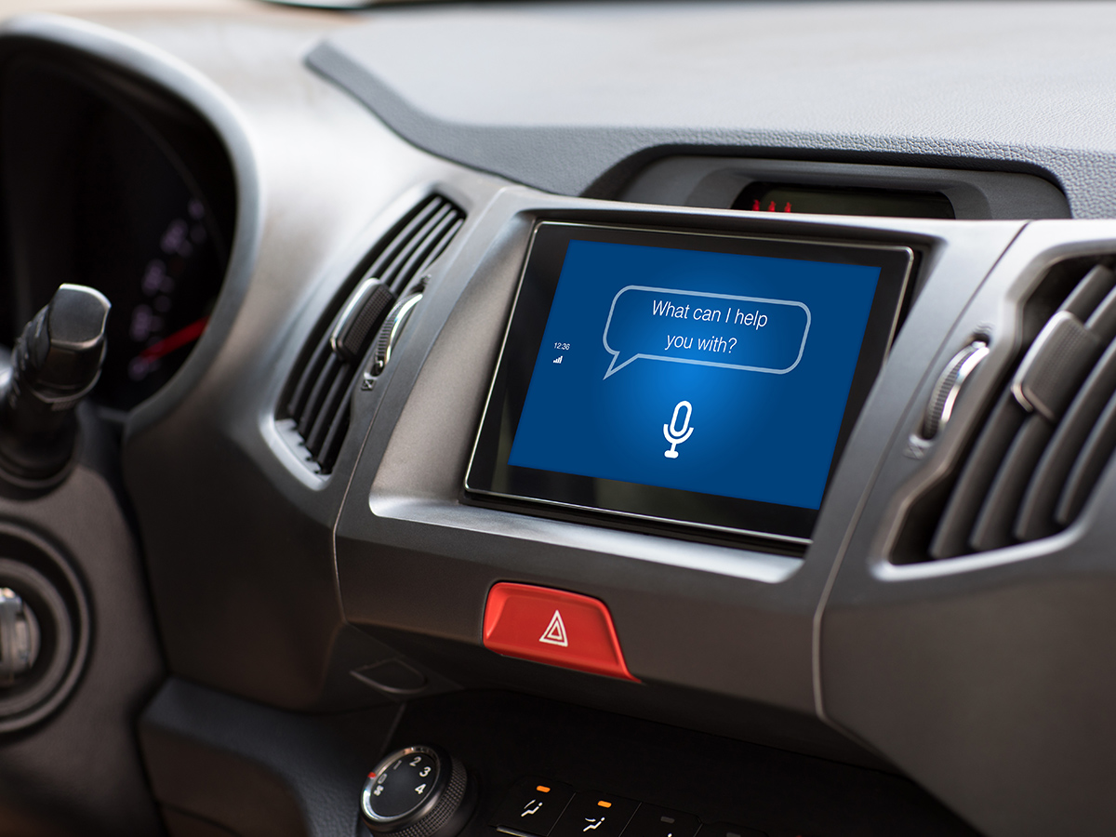

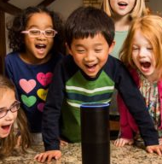

Research Goal
Long-term goal: more general natural language processing (NLP) systems through unified algorithms and theories.
Why? AI-driven language interfaces that increasingly integrate in our life need to be versatile.

Slide 40
Long-term goal: more general natural language processing (NLP) systems through unified algorithms and theories.
Notes:
In my past work, I have approached this goal by studying various facets to generality of models.
I have focused developing:
Systems that can generalize to a broader range of datasets.
Systems that can solve more complex abilities
As well as other aspects to the progress in general NLP, such as
commonsense knowledge in models
And their alignment with our societal values.
Along different methodological directions:

Slide 41
Long-term goal: more general natural language processing (NLP) systems through unified algorithms and theories.
Generalization in “breadth”
Natural Instructions
ACL ‘22
UnifiedQA
EMNLP Findings ’20
Contrast-Sets
EMNLP Findings ’20
Natural Perturbations
EMNLP ’20
ZOE
EMNLP ’18

Slide 42
Long-term goal: more general natural language processing (NLP) systems through unified algorithms and theories.
Generalization in “breadth”
Generalization in “depth”
Natural Instructions
ACL ‘22
ModularQA
NAACL ’21
UnifiedQA
EMNLP Findings ’20
StrategyQA
TACL ‘21
Contrast-Sets
EMNLP Findings ’20
MultiRC
NAACL ’18
Natural Perturbations
EMNLP ’20
SemanticILP
AAAI ’18
ZOE
EMNLP ’18
TableILP
IJCAI ’16

Slide 43
Long-term goal: more general natural language processing (NLP) systems through unified algorithms and theories.
Generalization in “breadth”
Generalization in “depth”
Commonsense ability
Natural Instructions
ACL ‘22
ModularQA
NAACL ’21
TransOMCS
IJCAI ‘20
UnifiedQA
EMNLP Findings ’20
StrategyQA
TACL ‘21
TACO-LM
ACL ‘20
Contrast-Sets
EMNLP Findings ’20
MultiRC
NAACL ’18
MC-TACO
EMNLP ‘19
Natural Perturbations
EMNLP ’20
SemanticILP
AAAI ’18
Hard Coreference
NAACL ‘15
ZOE
EMNLP ’18
TableILP
IJCAI ’16

Slide 44
Long-term goal: more general natural language processing (NLP) systems through unified algorithms and theories.
Generalization in “breadth”
Generalization in “depth”
Commonsense ability
Alignment with societal values
Natural Instructions
ACL ‘22
ModularQA
NAACL ’21
TransOMCS
IJCAI ‘20
Ethical Advice Taker
ACL Findings ‘21
UnifiedQA
EMNLP Findings ’20
StrategyQA
TACL ‘21
TACO-LM
ACL ‘20
UnQover
EMNLP Findings ‘20
Contrast-Sets
EMNLP Findings ’20
MultiRC
NAACL ’18
MC-TACO
EMNLP ‘19
Perspectrum
NAACL ‘19
Natural Perturbations
EMNLP ’20
SemanticILP
AAAI ’18
Hard Coreference
NAACL ‘15
ZOE
EMNLP ’18
TableILP
IJCAI ’16

Slide 45
Long-term goal: more general natural language processing (NLP) systems through unified algorithms and theories.
Generalization in “breadth”
Generalization in “depth”
Commonsense ability
Alignment with societal values
Natural Instructions
ACL ‘22
ModularQA
NAACL ’21
TransOMCS
IJCAI ‘20
Ethical Advice Taker
ACL Findings ‘21
Diagnosis
UnifiedQA
EMNLP Findings ’20
StrategyQA
TACL ‘21
TACO-LM
ACL ‘20
UnQover
EMNLP Findings ‘20
Contrast-Sets
EMNLP Findings ’20
MultiRC
NAACL ’18
MC-TACO
EMNLP ‘19
Perspectrum
NAACL ‘19
Natural Perturbations
EMNLP ’20
SemanticILP
AAAI ’18
Hard Coreference
NAACL ‘15
ZOE
EMNLP ’18
TableILP
IJCAI ’16
Notes:
Some focusing on “diagnostics” or identifying the problems.

Slide 46
Long-term goal: more general natural language processing (NLP) systems through unified algorithms and theories.
Generalization in “breadth”
Generalization in “depth”
Commonsense ability
Alignment with societal values
Natural Instructions
ACL ‘22
ModularQA
NAACL ’21
TransOMCS
IJCAI ‘20
Ethical Advice Taker
ACL Findings ‘21
Diagnosis
UnifiedQA
EMNLP Findings ’20
StrategyQA
TACL ‘21
TACO-LM
ACL ‘20
UnQover
EMNLP Findings ‘20
Problem Definition
Contrast-Sets
EMNLP Findings ’20
MultiRC
NAACL ’18
MC-TACO
EMNLP ‘19
Perspectrum
NAACL ‘19
Natural Perturbations
EMNLP ’20
SemanticILP
AAAI ’18
Hard Coreference
NAACL ‘15
ZOE
EMNLP ’18
TableILP
IJCAI ’16
Notes:
Some formalize a problem through quantitat

Slide 47
Long-term goal: more general natural language processing (NLP) systems through unified algorithms and theories.
Generalization in “breadth”
Generalization in “depth”
Commonsense ability
Alignment with societal values
Natural Instructions
ACL ‘22
ModularQA
NAACL ’21
TransOMCS
IJCAI ‘20
Ethical Advice Taker
ACL Findings ‘21
Diagnosis
UnifiedQA
EMNLP Findings ’20
StrategyQA
TACL ‘21
TACO-LM
ACL ‘20
UnQover
EMNLP Findings ‘20
Problem Definition
Contrast-Sets
EMNLP Findings ’20
MultiRC
NAACL ’18
MC-TACO
EMNLP ‘19
Perspectrum
NAACL ‘19
Solution
Natural Perturbations
EMNLP ’20
SemanticILP
AAAI ’18
Hard Coreference
NAACL ‘15
ZOE
EMNLP ’18
TableILP
IJCAI ’16
Notes:
And some propose solutions to existing problems.
For the purpose of this talk, I am going to focus on three projects specifically:

Slide 48

Long-term goal: more general natural language processing (NLP) systems through unified algorithms and theories.
Generalization in “breadth”
Generalization in “depth”
Commonsense ability
Alignment with societal values
Natural Instructions
ACL ‘22
ModularQA
NAACL ’21
TransOMCS
IJCAI ‘20
Ethical Advice Taker
ACL Findings ‘21
Diagnosis
UnifiedQA
EMNLP Findings ’20
StrategyQA
TACL ‘21
TACO-LM
ACL ‘20
UnQover
EMNLP Findings ‘20
Problem Definition
Contrast-Sets
EMNLP Findings ’20
MultiRC
NAACL ’18
MC-TACO
EMNLP ‘19
Perspectrum
NAACL ‘19
Solution
Natural Perturbations
EMNLP ’20
SemanticILP
AAAI ’18
Hard Coreference
NAACL ‘15
ZOE
EMNLP ’18
TableILP
IJCAI ’16

Slide 49
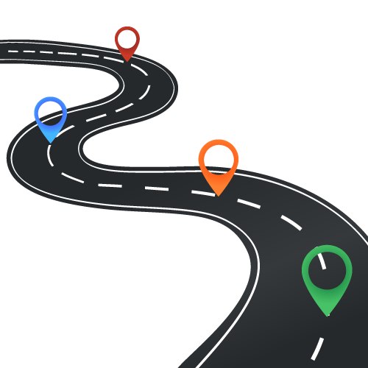
Talk Outline
Generality in “breadth” — tackling a variety of tasks
Future work:
Toward broad, interactive reasoning
Generality in “depth” — tackling more complex tasks
UnifiedQA
EMNLP Findings ’20
Natural Instructions
ACL ‘22
ModularQA
NAACL ’21
Notes:
In the first part, I am going to talk about progress on the breadth …
In the 2nd part …
Finally, I’ll highlight the the limitations of the current approaches and propose future plans toward “broad interactive reasoning”.

Slide 50
Talk Outline
Generality in “breadth” — tackling a variety of tasks
Future work:
Toward broad, interactive reasoning
Generality in “depth” — tackling more complex tasks
UnifiedQA
EMNLP Findings ’20
Natural Instructions
ACL ‘22
ModularQA
NAACL ’21

Slide 51
Talk Outline
Generality in “breadth” — tackling a variety of tasks
Future work:
Toward broad, interactive reasoning
Generality in “depth” — tackling more complex tasks
UnifiedQA
EMNLP Findings ’20
Natural Instructions
ACL ‘22
ModularQA
NAACL ’21

Slide 52
Talk Outline
Generality in “breadth” — tackling a variety of tasks
Future work:
Toward broad, interactive reasoning
Generality in “depth” — tackling more complex tasks
comprehension
reasoning
Interaction
UnifiedQA
EMNLP Findings ’20
Natural Instructions
ACL ‘22
ModularQA
NAACL ’21

Slide 53
Talk Outline
Generality in “breadth” — tackling a variety of tasks
Future work:
Toward broad, interactive reasoning
Generality in “depth” — tackling more complex tasks
comprehension
reasoning
Interaction
UnifiedQA
EMNLP Findings ’20
Natural Instructions
ACL ‘22
ModularQA
NAACL ’21

Slide 54
general language understanding
G
…
… …
T1
T2
T3
tasks
…
… …
simpler tasks
T1a
T1b
T1c
Notes:
To begin with, let me go back to the generalization hierarchy.
In particular, let’s focus on a sub-hierarchy here.

Slide 55
general language understanding
G
…
… …
T1
T2
T3
tasks
…
… …
simpler tasks
T1a
T1b
T1c

Slide 56

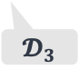
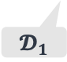
T1
T2
T3
$$𝓓_{1}$$
$$𝓓_{2}$$
$$𝓓_{3}$$
Notes:
Like I said earlier, the dominant paradigm for tackling tasks has been to train models specialized to datasets.
Which can lead to strong models on individual datasets,
however, they can be limiting since:
These models over-rely on assumptions of the data they’re trained on, which create barriers for generalization to other relevant tasks.
Having a model per task is just unrealistic and unscalable.
There are MANY tasks out there
There is no way that we can build annotate datasets for every task.
In fact, there are tasks that we haven’t even defined yet.

Slide 57

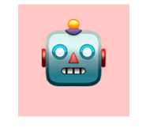
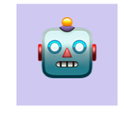
T1
T2
T3
$$𝓓_{1}$$
$$𝓓_{2}$$
$$𝓓_{3}$$
$$\text{🤖}$$
$$\text{🤖}$$
$$\text{🤖}$$
dataset-specific models

Slide 58
T1
T2
T3
$$𝓓_{1}$$
$$𝓓_{2}$$
$$𝓓_{3}$$
$$\text{🤖}$$
$$\text{🤖}$$
$$\text{🤖}$$
dataset-specific models
🚫
Task specific assumptions prevent generalization!

Slide 59
T1
T2
T3
$$𝓓_{1}$$
$$𝓓_{2}$$
$$𝓓_{3}$$
$$\text{🤖}$$
$$\text{🤖}$$
$$\text{🤖}$$
dataset-specific models
🚫
There are MANY tasks — this is not scalable!
Task specific assumptions prevent generalization!

Slide 60

T1
T2
T3
$$𝓓_{1}$$
$$𝓓_{2}$$
$$𝓓_{3}$$
$$\text{🤖}$$
Research questions: How can we build a system that tackles a variety of language tasks?
Notes:
This naturally brings us to the question of: …

Slide 61
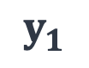
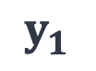


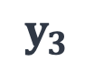
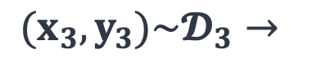



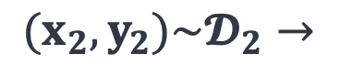
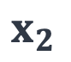


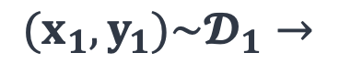
$${(x}_{1}, y_{1})\sim 𝓓_{1}→$$
$$x_{1}$$
$$y_{1}$$
$$\text{🤖}$$
T1
T2
T3
$${(x}_{2},y_{2})\sim 𝓓_{2}→$$
$$x_{2}$$
$$y_{1}$$
$$𝓓_{1}$$
$$𝓓_{2}$$
$$𝓓_{3}$$
$$\text{🤖}$$
$$(x_{3},y_{3})\sim 𝓓_{3}→$$
$$x_{3}$$
$$y_{3}$$
Research questions: How can we build a system that tackles a variety of language tasks?
Notes:
More concretely, we’d like to have a single model which maps input instances of different datasets to appropriate outputs.

Slide 62
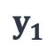

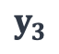

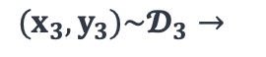


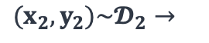

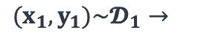
Multi-task learning [Caruana '97; McCann et al. ’18]
T1
T2
T3
$$𝓓_{1}$$
$$𝓓_{2}$$
$$𝓓_{3}$$
$$\text{🤖}$$
$$x_{1}$$
$$y_{1}$$
$${(x}_{1}, y_{1})\sim 𝓓_{1}→$$
$$\text{🤖}$$
$$x_{2}$$
$$y_{1}$$
$${(x}_{2},y_{2})\sim 𝓓_{2}→$$
$$x_{3}$$
$$y_{3}$$
$$(x_{3},y_{3})\sim 𝓓_{3}→$$
Notes:
Turns out that there is a rich literature on this idea within statistical learning, under the broader area of “multi-task learning”,
usually defined as …
… which has been around for decades
So, for moment it might seem like we have the solution right here. … but … not so easy.
The challenge here is “negative transfer”,
multi-task learning can actually hurt the performance, if there is not enough commonalities among the tasks.

Slide 63
Multi-task learning [Caruana '97; McCann et al. ’18]
Solving multiple learning tasks at the same time, while exploiting commonalities across tasks.
T1
T2
T3
$$𝓓_{1}$$
$$𝓓_{2}$$
$$𝓓_{3}$$
$$\text{🤖}$$
$$x_{1}$$
$$y_{1}$$
$${(x}_{1}, y_{1})\sim 𝓓_{1}→$$
$$\text{🤖}$$
$$x_{2}$$
$$y_{1}$$
$${(x}_{2},y_{2})\sim 𝓓_{2}→$$
$$x_{3}$$
$$y_{3}$$
$$(x_{3},y_{3})\sim 𝓓_{3}→$$

Slide 64
Multi-task learning [Caruana '97; McCann et al. ’18]
Challenge: negative transfer:
multi-tasking can hurt, if there is not enough commonalities among the tasks.
Solving multiple learning tasks at the same time, while exploiting commonalities across tasks.
T1
T2
T3
$$𝓓_{1}$$
$$𝓓_{2}$$
$$𝓓_{3}$$
$$\text{🤖}$$
$$x_{1}$$
$$y_{1}$$
$${(x}_{1}, y_{1})\sim 𝓓_{1}→$$
$$\text{🤖}$$
$$x_{2}$$
$$y_{1}$$
$${(x}_{2},y_{2})\sim 𝓓_{2}→$$
$$x_{3}$$
$$y_{3}$$
$$(x_{3},y_{3})\sim 𝓓_{3}→$$

Slide 65
Multi-task learning [Caruana '97; McCann et al. ’18]
Challenge: negative transfer:
multi-tasking can hurt, if there is not enough commonalities among the tasks.
Solving multiple learning tasks at the same time, while exploiting commonalities across tasks.
T1
T2
T3
$$𝓓_{1}$$
$$𝓓_{2}$$
$$𝓓_{3}$$
$$\text{🤖}$$
$$x_{1}$$
$$y_{1}$$
$${(x}_{1}, y_{1})\sim 𝓓_{1}→$$
$$\text{🤖}$$
$$x_{2}$$
$$y_{1}$$
$${(x}_{2},y_{2})\sim 𝓓_{2}→$$
$$x_{3}$$
$$y_{3}$$
$$(x_{3},y_{3})\sim 𝓓_{3}→$$
Notes:
So the question of success of multi-task learning comes down to…
And I am going to address this question, in the context of two project: ….

Slide 66
Multi-task learning [Caruana '97; McCann et al. ’18]
Challenge: negative transfer:
multi-tasking can hurt, if there is not enough commonalities among the tasks.
Solving multiple learning tasks at the same time, while exploiting commonalities across tasks.
T1
T2
T3
$$𝓓_{1}$$
$$𝓓_{2}$$
$$𝓓_{3}$$
$$\text{🤖}$$
$$x_{1}$$
$$y_{1}$$
$${(x}_{1}, y_{1})\sim 𝓓_{1}→$$
Multi-Task Learning in NLP: How can we leverage (or induce) commonalities among language tasks?
$$\text{🤖}$$
$$x_{2}$$
$$y_{1}$$
$${(x}_{2},y_{2})\sim 𝓓_{2}→$$
$$x_{3}$$
$$y_{3}$$
$$(x_{3},y_{3})\sim 𝓓_{3}→$$

Slide 67
T1
T2
T3
$$𝓓_{1}$$
$$𝓓_{2}$$
$$𝓓_{3}$$
$$\text{🤖}$$
$$x_{1}$$
$$y_{1}$$
$${(x}_{1}, y_{1})\sim 𝓓_{1}→$$
Multi-Task Learning in NLP: How can we leverage (or induce) commonalities among language tasks?
$$\text{🤖}$$
$$x_{2}$$
$$y_{1}$$
$${(x}_{2},y_{2})\sim 𝓓_{2}→$$
$$x_{3}$$
$$y_{3}$$
$$(x_{3},y_{3})\sim 𝓓_{3}→$$
Notes:
And I am going to address this question, in the context of two project:
First, multi-tasking of different variants of answering questions
Second, multi-tasking among common NLP tasks
And for each of these, I’m discuss what element of the representation creates the commonality among the tasks at hand and results in positive transfer.
Just to emphasize the non-triviality of this issue, I highlight one recent work that studies multi-tasking in the context of NLP tasks.
Which happens to be the well-known work that has introduced the T5 language model.
As Raffel et al put it: …
Now, in the studies here, I’m gonna do something similar:
We’re gonna use the same neural language model (T5) to do multi-task learning, under slightly different settings
Except that we will see positive transfer among our tasks.

Slide 68

T1
T2
T3
Answering Questions
$$𝓓_{1}$$
$$𝓓_{2}$$
$$𝓓_{3}$$
$$\text{🤖}$$
$$x_{1}$$
$$y_{1}$$
$${(x}_{1}, y_{1})\sim 𝓓_{1}→$$
Multi-Task Learning in NLP: How can we leverage (or induce) commonalities among language tasks?
$$\text{🤖}$$
$$x_{2}$$
$$y_{1}$$
$${(x}_{2},y_{2})\sim 𝓓_{2}→$$
$$x_{3}$$
$$y_{3}$$
$$(x_{3},y_{3})\sim 𝓓_{3}→$$

Slide 69

T1
T2
T3
Answering Questions
Common NLP tasks
$$𝓓_{1}$$
$$𝓓_{2}$$
$$𝓓_{3}$$
$$\text{🤖}$$
$$x_{1}$$
$$y_{1}$$
$${(x}_{1}, y_{1})\sim 𝓓_{1}→$$
Multi-Task Learning in NLP: How can we leverage (or induce) commonalities among language tasks?
$$\text{🤖}$$
$$x_{2}$$
$$y_{1}$$
$${(x}_{2},y_{2})\sim 𝓓_{2}→$$
$$x_{3}$$
$$y_{3}$$
$$(x_{3},y_{3})\sim 𝓓_{3}→$$

Slide 70
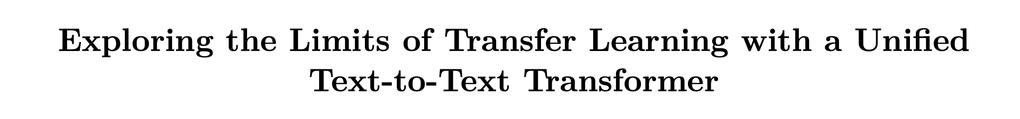
[Raffel et al. 2020]
T5
T1
T2
T3
Answering Questions
Common NLP tasks
$$𝓓_{1}$$
$$𝓓_{2}$$
$$𝓓_{3}$$
$$\text{🤖}$$
$$x_{1}$$
$$y_{1}$$
$${(x}_{1}, y_{1})\sim 𝓓_{1}→$$
Multi-Task Learning in NLP: How can we leverage (or induce) commonalities among language tasks?
$$\text{🤖}$$
$$x_{2}$$
$$y_{1}$$
$${(x}_{2},y_{2})\sim 𝓓_{2}→$$
$$x_{3}$$
$$y_{3}$$
$$(x_{3},y_{3})\sim 𝓓_{3}→$$

Slide 71
“…. we find that multi-task training underperforms fine-tuning on most tasks”
[Raffel et al. 2020]
T5
T1
T2
T3
Answering Questions
Common NLP tasks
$$𝓓_{1}$$
$$𝓓_{2}$$
$$𝓓_{3}$$
$$\text{🤖}$$
$$x_{1}$$
$$y_{1}$$
$${(x}_{1}, y_{1})\sim 𝓓_{1}→$$
Multi-Task Learning in NLP: How can we leverage (or induce) commonalities among language tasks?
$$\text{🤖}$$
$$x_{2}$$
$$y_{1}$$
$${(x}_{2},y_{2})\sim 𝓓_{2}→$$
$$x_{3}$$
$$y_{3}$$
$$(x_{3},y_{3})\sim 𝓓_{3}→$$

Slide 72
“…. we find that multi-task training underperforms fine-tuning on most tasks”
[Raffel et al. 2020]
T5
T1
T2
T3
Answering Questions
Common NLP tasks
$$𝓓_{1}$$
$$𝓓_{2}$$
$$𝓓_{3}$$
$$\text{🤖}$$
$$x_{1}$$
$$y_{1}$$
$${(x}_{1}, y_{1})\sim 𝓓_{1}→$$
Multi-Task Learning in NLP: How can we leverage (or induce) commonalities among language tasks?
$$\text{🤖}$$
$$x_{2}$$
$$y_{1}$$
$${(x}_{2},y_{2})\sim 𝓓_{2}→$$
$$x_{3}$$
$$y_{3}$$
$$(x_{3},y_{3})\sim 𝓓_{3}→$$

Slide 73

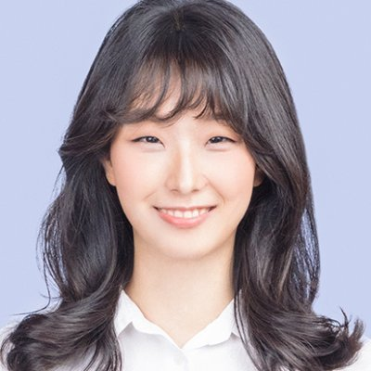
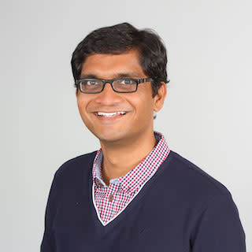
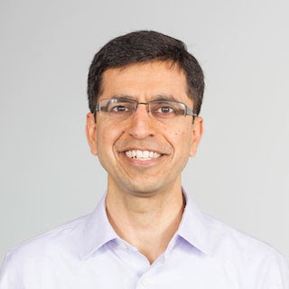


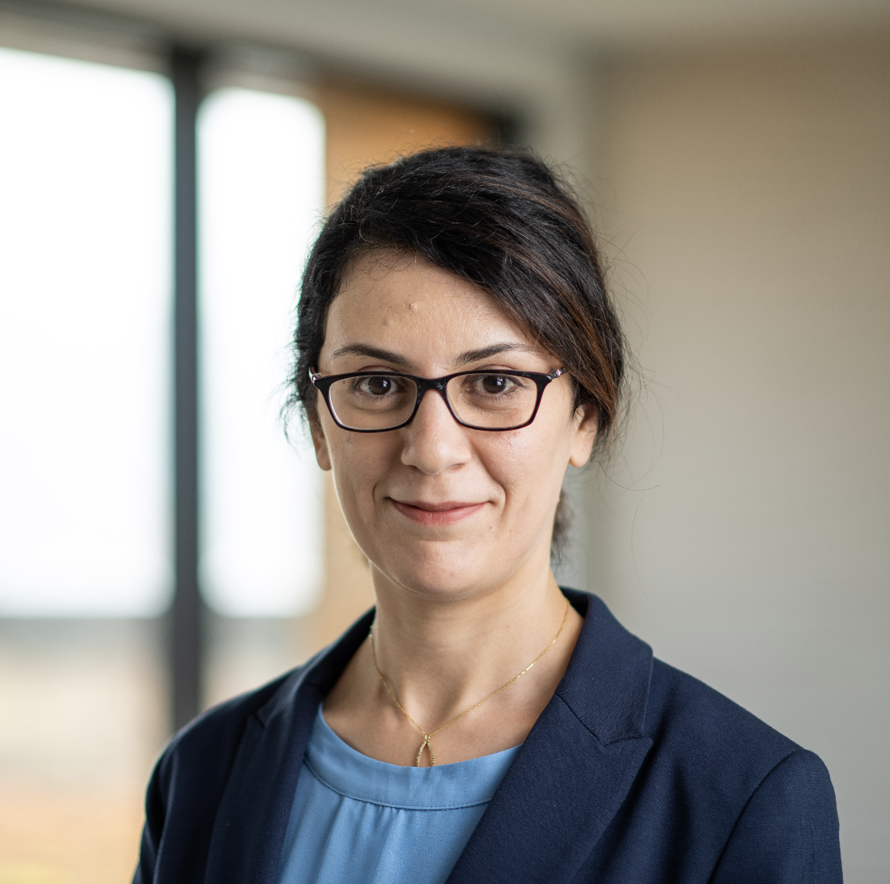
UnifiedQA
Answering a broad range of questions with a single system
Daniel Khashabi, Sewon Min, Tushar Khot, Ashish Sabharwal Oyvind Tafjord, Peter Clark and Hannaneh Hajishirzi
EMNLP Findings 2020

Slide 74
Answering Questions: Sub-tasks
…
…
Quail
…
MCScript
GooAQ
OBQA
BoolQ
MMMLU
ReCorD
DROP
PROST
SQuAD1
SQuAD 2
ComQA
QAConv
…
TREC-8
TREC-9
TREC-2001-2005.
MCTest
RACE
ARC
WinoGrande
StrategyQA
2000 2005 2010 2015 2020
Notes:
There has been an explosion of activity on this problem in the past few years, as it can be seen by the number of datasets released.
What is is not visible in this plot is that, not all of these datasets follow the same design conventions.
If you step back ..

Slide 75
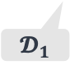

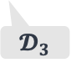
Answering Questions: Sub-tasks
tasks for answering questions
T1
T2
T3
$$𝓓_{1}$$
$$𝓓_{2}$$
$$𝓓_{3}$$
ARC
RACE
ReCorD
SQuAD1
BoolQ
StrategyQA
Multiple-Choice questions
Reading-Comprehension questions
Yes/No Questions
Notes:
If you step back and place them on our generalization hierarchy, a more clear image would emerge.
Essentially, these datasets form clusters around different variants for answering questions.

Slide 76

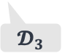
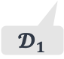
Answering Questions: Sub-tasks
tasks for answering questions
T1
T2
T3
$$𝓓_{1}$$
$$𝓓_{2}$$
$$𝓓_{3}$$
ARC
RACE
ReCorD
SQuAD1
BoolQ
StrategyQA
Multiple-Choice questions
Reading-Comprehension questions
Yes/No Questions
Notes:
Just to give a better sense of how these look like:
here is one multiple-choice question.
[read the question].
A question is supplemented with a bunch of candidate answers
Here is a reading comprehension instance,
Given a question, one has to find the answer as a substring of the given context paragraph.

Slide 77
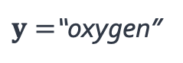
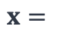
Answering Questions: Sub-tasks
Question: “What does photosynthesis produce that helps plants grow?”
Candidates: (A) water (B) oxygen (C) protein (D) sugar
$$x=$$
$y=$“oxygen”
multiple-choice
tasks for answering questions
[Clark et al. 18]
T1
T2
T3
$$𝓓_{1}$$
$$𝓓_{2}$$
$$𝓓_{3}$$
ARC
RACE
ReCorD
SQuAD1
BoolQ
StrategyQA
Multiple-Choice questions
Reading-Comprehension questions
Yes/No Questions

Slide 78
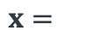
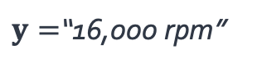
Answering Questions: Sub-tasks
Question: “What does photosynthesis produce that helps plants grow?”
Candidates: (A) water (B) oxygen (C) protein (D) sugar
$$x=$$
$y=$“oxygen”
multiple-choice
tasks for answering questions
[Clark et al. 18]
T1
T2
T3
Question: “At what speed did the turbine operate?”
Context: On his 50th birthday in 1906, Tesla demonstrated ….
$$x=$$
$y=$“16,000 rpm”
$$𝓓_{1}$$
$$𝓓_{2}$$
$$𝓓_{3}$$
ARC
RACE
ReCorD
SQuAD1
BoolQ
StrategyQA
reading-comprehension
Multiple-Choice questions
Reading-Comprehension questions
Yes/No Questions
[Rajpurkar et al. ‘16]

Slide 79


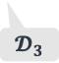
Answering Questions: Sub-tasks
Question: “What does photosynthesis produce that helps plants grow?”
Candidates: (A) water (B) oxygen (C) protein (D) sugar
$$x=$$
$y=$“oxygen”
tasks for answering questions
multiple-choice
T1
T2
T3
$$𝓓_{1}$$
$$𝓓_{2}$$
$$𝓓_{3}$$
Question: “At what speed did the turbine operate?”
Context: On his 50th birthday in 1906, Tesla demonstrated ….
ARC
RACE
ReCorD
SQuAD
BoolQ
StrategyQA
Multiple-Choice questions
Reading-Comprehension questions
Yes/No Questions
$$x=$$
$y=$“16,000 rpm”
reading-comprehension

Slide 80
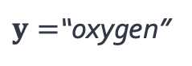
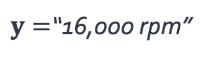
Toward Unified Question Answering
Question: “What does photosynthesis produce that helps plants grow?”
Candidates: (A) water (B) oxygen (C) protein (D) sugar
$$x=$$
$y=$“oxygen”
tasks for answering questions
multiple-choice
T1
T2
T3
$$𝓓_{1}$$
$$𝓓_{2}$$
$$𝓓_{3}$$
Question: “At what speed did the turbine operate?”
Context: On his 50th birthday in 1906, Tesla demonstrated ….
ARC
RACE
ReCorD
SQuAD
BoolQ
StrategyQA
Multiple-Choice questions
Reading-Comprehension questions
Yes/No Questions
$$x=$$
$y=$“16,000 rpm”
reading-comprehension
Notes:
Now, we want to build a single system that can answer these slightly different variants of question answering.

Slide 81

Toward Unified Question Answering
Question: “What does photosynthesis produce that helps plants grow?”
Candidates: (A) water (B) oxygen (C) protein (D) sugar
$$x=$$
$y=$“oxygen”
tasks for answering questions
multiple-choice
$$\text{🤖}$$
T1
T2
T3
$$𝓓_{1}$$
$$𝓓_{2}$$
$$𝓓_{3}$$
Question: “At what speed did the turbine operate?”
Context: On his 50th birthday in 1906, Tesla demonstrated ….
ARC
RACE
ReCorD
SQuAD
BoolQ
StrategyQA
Multiple-Choice questions
Reading-Comprehension questions
Yes/No Questions
$$x=$$
$y=$“16,000 rpm”
reading-comprehension

Slide 82



Toward Unified Question Answering
tasks for answering questions
T1
T2
T3
Question: “What does photosynthesis produce that helps plants grow?”
Candidates: (A) water (B) oxygen (C) protein (D) sugar
$$𝓓_{1}$$
$$𝓓_{2}$$
$$𝓓_{3}$$
ARC
RACE
ReCorD
SQuAD
BoolQ
StrategyQA
$$x=$$
$y=$“oxygen”
Multiple-Choice questions
Reading-Comprehension questions
Yes/No Questions
multiple-choice
$$\text{🤖}$$
Question: “At what speed did the turbine operate?”
Context: On his 50th birthday in 1906, Tesla demonstrated ….
$$x=$$
$y=$“16,000 rpm”
Multi-Task Learning in NLP: How can we leverage (induce) commonalities among language tasks?
reading-comprehension
Question Answering
Notes:
And like I said, the main question is whether there is enough commonality among our tasks.
The intuition guiding is that,
While all these tasks are different …

Slide 83
Toward Unified Question Answering
tasks for answering questions
T1
T2
T3
Question: “What does photosynthesis produce that helps plants grow?”
Candidates: (A) water (B) oxygen (C) protein (D) sugar
$$𝓓_{1}$$
$$𝓓_{2}$$
$$𝓓_{3}$$
ARC
RACE
ReCorD
SQuAD
BoolQ
StrategyQA
$$x=$$
$y=$“oxygen”
Multiple-Choice questions
Reading-Comprehension questions
Yes/No Questions
different but relevant
multiple-choice
$$\text{🤖}$$
Question: “At what speed did the turbine operate?”
Context: On his 50th birthday in 1906, Tesla demonstrated ….
$$x=$$
$y=$“16,000 rpm”
Multi-Task Learning in NLP: How can we leverage (induce) commonalities among language tasks?
reading-comprehension
Question Answering

Slide 84
Toward Unified Question Answering
tasks for answering questions
T1
T2
T3
Question: “What does photosynthesis produce that helps plants grow?”
Candidates: (A) water (B) oxygen (C) protein (D) sugar
$$𝓓_{1}$$
$$𝓓_{2}$$
$$𝓓_{3}$$
ARC
RACE
ReCorD
SQuAD
BoolQ
StrategyQA
$$x=$$
$y=$“oxygen”
Multiple-Choice questions
Reading-Comprehension questions
Yes/No Questions
different but relevant
multiple-choice
$$\text{🤖}$$
Hypothesis: “questions” induce sharedness among QA subtasks.
Question: “At what speed did the turbine operate?”
Context: On his 50th birthday in 1906, Tesla demonstrated ….
$$x=$$
$y=$“16,000 rpm”
Multi-Task Learning in NLP: How can we leverage (induce) commonalities among language tasks?
reading-comprehension
Question Answering
Notes:
…. they're relevant ways of discussing questions
the underlying reasoning phenomena with respect to question might be similar
So "questions" here are really the first order citizens
[Hypothesis] and their mere existence might be enough …
And result in positive transfer
I’ll just add that, this is a very simple observation — almost trivial. Even though at the time, not many thought that it might work (including some of my managers).
Which gave me reasons to studying it empirically

Slide 85



tasks for answering questions
Hypothesis: “questions” induce sharedness among QA subtasks.
T1
T2
T3
$$𝓓_{1}$$
$$𝓓_{2}$$
$$𝓓_{3}$$
ARC
RACE
ReCorD
SQuAD
BoolQ
StrategyQA
Multiple-Choice questions
Reading-Comprehension questions
Yes/No Questions
Notes:
To verify this hypothesis empirically,
We experiment comparing whether addition of mixing pairs of different QA tasks can improve the performance.
For example, is it better to train a model on RACE or a model on RACE + SQuAD (even though one is … and other one is ..)?
Turns out that the latter gives you 5% improvement.
This was a surprise finding at the time, since we’re getting these gains by seemingly odd combinations of datasets.
In further experiment, , we observed similar gains for many dataset pairs of different QA variants.
Which lends support to hypothesis (on sufficiency of questions for positive transfer).
This is good! But now that we see this positive transfer between pairs of dataset, why stop here? (let’s make bigger combinations).

Slide 86
tasks for answering questions
Hypothesis: “questions” induce sharedness among QA subtasks.
T1
T2
T3
$$𝓓_{1}$$
$$𝓓_{2}$$
$$𝓓_{3}$$
ARC
RACE
ReCorD
SQuAD
BoolQ
StrategyQA
Multiple-Choice questions
Reading-Comprehension questions
Yes/No Questions
Pairwise transferability: gain in mixing pairs of QA tasks?

Slide 87
tasks for answering questions
Hypothesis: “questions” induce sharedness among QA subtasks.
T1
T2
T3
$$𝓓_{1}$$
$$𝓓_{2}$$
$$𝓓_{3}$$
60
55
50
ARC
RACE
ReCorD
SQuAD
BoolQ
StrategyQA
Multiple-Choice questions
Reading-Comprehension questions
Yes/No Questions
Pairwise transferability: gain in mixing pairs of QA tasks?
Accuracy (higher is better)
Evaluation on RACE
[Lai et al. 17]

Slide 88

tasks for answering questions
Hypothesis: “questions” induce sharedness among QA subtasks.
T1
T2
T3
$$𝓓_{1}$$
$$𝓓_{2}$$
$$𝓓_{3}$$
60
55
50
ARC
RACE
ReCorD
SQuAD
BoolQ
StrategyQA
Multiple-Choice questions
Reading-Comprehension questions
Yes/No Questions
Pairwise transferability: gain in mixing pairs of QA tasks?
$$\text{🤖}$$
Accuracy (higher is better)
55.8
Evaluation on RACE
[Lai et al. 17]

Slide 89

tasks for answering questions
Hypothesis: “questions” induce sharedness among QA subtasks.
T1
T2
T3
$$𝓓_{1}$$
$$𝓓_{2}$$
$$𝓓_{3}$$
60
55
50
ARC
RACE
ReCorD
SQuAD
BoolQ
StrategyQA
Multiple-Choice questions
Reading-Comprehension questions
Yes/No Questions
Pairwise transferability: gain in mixing pairs of QA tasks?
$$\text{🤖}$$
$$\text{🤖}$$
59.1
Accuracy (higher is better)
55.8
Evaluation on RACE
[Lai et al. 17]

Slide 90
tasks for answering questions
Hypothesis: “questions” induce sharedness among QA subtasks.
T1
T2
T3
$$𝓓_{1}$$
$$𝓓_{2}$$
$$𝓓_{3}$$
60
55
50
ARC
RACE
ReCorD
SQuAD
BoolQ
StrategyQA
Multiple-Choice questions
Reading-Comprehension questions
Yes/No Questions
Pairwise transferability: gain in mixing pairs of QA tasks?
$$\text{🤖}$$
Yes, mixing datasets of different QA subtasks often leads to positive transfer.
$$\text{🤖}$$
59.1
Accuracy (higher is better)
55.8
Evaluation on RACE
[Lai et al. 17]

Slide 91
tasks for answering questions
Hypothesis: “questions” induce sharedness among QA subtasks.
T1
T2
T3
✅
$$𝓓_{1}$$
$$𝓓_{2}$$
$$𝓓_{3}$$
60
55
50
ARC
RACE
ReCorD
SQuAD
BoolQ
StrategyQA
Multiple-Choice questions
Reading-Comprehension questions
Yes/No Questions
Pairwise transferability: gain in mixing pairs of QA tasks?
$$\text{🤖}$$
Yes, mixing datasets of different QA subtasks often leads to positive transfer.
$$\text{🤖}$$
59.1
Accuracy (higher is better)
55.8
Evaluation on RACE
[Lai et al. 17]

Slide 92
A Single Unified Model for QA
tasks for answering questions
T1
T2
T3
T4
Multiple Choice
Reading
Comprehension
Yes/No Questions
Open domain
Notes:
Motivated by these observations, we build systems trained on a mix of many formats.
Specifically we build UnifiedQA, ….
Which resulted in great positive surprises (which I’m gonna briefly glance over):
Across many benchmarks, UQA outperforms dataset-specific models, while offering the benefit of having a single model run on all of them.
Here UQA is highlighted in rainbow color

Slide 93
A Single Unified Model for QA
tasks for answering questions
T1
T2
T3
T4
Multiple Choice
Reading
Comprehension
Yes/No Questions
Open domain
UnifiedQA: a model trained on the union of datasets from four different QA tasks.

Slide 94
A Single Unified Model for QA
tasks for answering questions
T1
T2
T3
T4
Multiple Choice
Reading
Comprehension
Yes/No Questions
Open domain
UnifiedQA: a model trained on the union of datasets from four different QA tasks.
Summary of empirical results:

Slide 95
A Single Unified Model for QA
tasks for answering questions
T1
T2
T3
T4
Multiple Choice
Reading
Comprehension
Yes/No Questions
Open domain
UnifiedQA: a model trained on the union of datasets from four different QA tasks.
Summary of empirical results:
Outperforms dataset-specific models
“UnifiedQA: Crossing Format Boundaries With a Single QA System.” Khashabi and others EMNLP-Findings ‘20

Slide 96
A Single Unified Model for QA
tasks for answering questions
T1
T2
T3
T4
Multiple Choice
Reading
Comprehension
Yes/No Questions
Open domain
UnifiedQA: a model trained on the union of datasets from four different QA tasks.
Summary of empirical results:
Outperforms dataset-specific models
“UnifiedQA: Crossing Format Boundaries With a Single QA System.” Khashabi and others EMNLP-Findings ‘20
Notes:
Furthermore, upon doing additional fine-tuning UQA improved sota performance on 10 benchmarks.
Here I am highlighting few of these results.

Slide 97
A Single Unified Model for QA
tasks for answering questions
T1
T2
T3
T4
Multiple Choice
Reading
Comprehension
Yes/No Questions
Open domain
UnifiedQA: a model trained on the union of datasets from four different QA tasks.
Summary of empirical results:
Outperforms dataset-specific models
Improved state-of-art results on 10 datasets.
“UnifiedQA: Crossing Format Boundaries With a Single QA System.” Khashabi and others EMNLP-Findings ‘20

Slide 98
A Single Unified Model for QA
tasks for answering questions
T1
T2
T3
T4
Multiple Choice
Reading
Comprehension
Yes/No Questions
Open domain
UnifiedQA: a model trained on the union of datasets from four different QA tasks.
Summary of empirical results:
Outperforms dataset-specific models
Improved state-of-art results on 10 datasets.
85
75
65
87
84
Accuracy (higher is better)
78
78
79
UnifiedQA fine-tune
No unified training
70
ARC
CommonsenseQA
OBQA
[Clark et al. 18] [Talmor et al. 19] [Khot et al. 19]
“UnifiedQA: Crossing Format Boundaries With a Single QA System.” Khashabi and others EMNLP-Findings ‘20

Slide 99
A Single Unified Model for QA
tasks for answering questions
T1
T2
T3
T4
Multiple Choice
Reading
Comprehension
Yes/No Questions
Open domain
UnifiedQA: a model trained on the union of datasets from four different QA tasks.
Summary of empirical results:
Outperforms dataset-specific models
Improved state-of-art results on 10 datasets.
Strong generalization to unseen datasets.
“UnifiedQA: Crossing Format Boundaries With a Single QA System.” Khashabi and others EMNLP-Findings ‘20
Notes:
And finally, UQA leads to strong generalization to “unseen” benchmarks, which I’m not gonna show due to our limited time.

Slide 100
UnifiedQA: Impact
Its empirical success was reproduced on new datasets.
[Bragg et al. ‘21; Wu et al. ‘21; Zhong et al. ‘21, …]
Notes:
Instead, I’m gonna point out several impacts of UQA since its publication:
First, the empirical success of UnifiedQA is reproduced on datasets that did not exist at the time.
I am showing several screenshots from followup papers.
which lends evidence to versatility of the resulting system.
In one particular case, UnifiedQA has stronger performance on this new QA benchmark than GPT3, a model that is 16× larger than UnifiedQA
Which we’re happy to see.

Slide 101






UnifiedQA: Impact
Its empirical success was reproduced on new datasets.
[Bragg et al. ‘21; Wu et al. ‘21; Zhong et al. ‘21, …]
$$\text{🤖}$$
$$\text{🤖}$$
Qasper [Dasigi et al. ’21]
MMMLU [Hendrycks et al. ’21]
$$\text{🤖}$$
QAConv [Wu et al. ’21]

Slide 102
UnifiedQA: Impact
Its empirical success was reproduced on new datasets.
[Bragg et al. ‘21; Wu et al. ‘21; Zhong et al. ‘21, …]
$$\text{🤖}$$
$$\text{🤖}$$
Qasper [Dasigi et al. ’21]
16x larger
MMMLU [Hendrycks et al. ’21]
$$\text{🤖}$$
QAConv [Wu et al. ’21]

Slide 103
UnifiedQA: Impact
Its empirical success was reproduced on new datasets.
[Bragg et al. ‘21; Wu et al. ‘21; Zhong et al. ‘21, …]
Notes:
Additionally, UQA’s success has somewhat helped alleviate the conceptual taboos against multi-task learning in NLP and building unified, broader models.
In less than two years, there have been several important follow-ups that extend our core idea to different problem spaces --- which is exciting.

Slide 104
UnifiedQA: Impact
Its empirical success was reproduced on new datasets.
Helped alleviated the conceptual barriers for building broader models.
Follow-ups works have applied these ideas to different problem spaces
[Bragg et al. ‘21; Wu et al. ‘21; Zhong et al. ‘21, …]
[Aghajanyan et al.'21, Gupta et al.'21, Jiang et al.21, Bragg et al. ‘21, Aribandi et al. 21, …]

Slide 105
Summary So Far
tasks for answering questions
T1
T2
T3
T4
Multiple Choice
Reading
Comprehension
Yes/No Questions
Open domain
Motivating Question: Can we build a more general individual system that can gains from tackling a variety of QA formats?
Yes we can!
Added incentive: there is value in mixing QA tasks.
UnifiedQA: a single QA system working across four common QA types
Open questions:
What about other non-QA tasks?
Notes:
This work is motivated by the question of ….
Answer is yes, indeed. There is incentive in doing so as well: we showed gains from mixing different QA (q tasks. And the by-product of the study is: UnifiedQA, a single pre-trained QA system that works across four common QA formats.
But clearly, this is not the end of our progress. There remains about questions on:
-

Slide 106
Summary So Far
tasks for answering questions
T1
T2
T3
T4
Multiple Choice
Reading
Comprehension
Yes/No Questions
Open domain
Motivating Question: Can we build a more general individual system that can gains from tackling a variety of QA formats?
Yes we can!
Added incentive: there is value in mixing QA tasks.
UnifiedQA: a single QA system working across four common QA types
Open questions:
What about other non-QA tasks?

Slide 107
Summary So Far
tasks for answering questions
T1
T2
T3
T4
Multiple Choice
Reading
Comprehension
Yes/No Questions
Open domain
Motivating Question: Can we build a more general individual system that can gains from tackling a variety of QA formats?
Yes we can!
Added incentive: there is value in mixing QA tasks.
UnifiedQA: a single QA system working across four common QA types
Open questions:
What about other non-QA tasks?

Slide 108
Summary So Far
tasks for answering questions
T1
T2
T3
T4
Multiple Choice
Reading
Comprehension
Yes/No Questions
Open domain
Motivating Question: Can we build a more general individual system that can gains from tackling a variety of QA formats?
Yes we can!
Added incentive: there is value in mixing QA tasks.
UnifiedQA: a single QA system working across four common QA types
Open questions:
What about other non-QA tasks?

Slide 109
Summary So Far
tasks for answering questions
T1
T2
T3
T4
Multiple Choice
Reading
Comprehension
Yes/No Questions
Open domain
Motivating Question: Can we build a more general individual system that can gains from tackling a variety of QA formats?
Yes we can!
Added incentive: there is value in mixing QA tasks.
UnifiedQA: a single QA system working across four common QA types
Open questions:
What about other non-QA tasks?

Slide 110
Summary So Far
tasks for answering questions
T1
T2
T3
T4
Multiple Choice
Reading
Comprehension
Yes/No Questions
Open domain
Motivating Question: Can we build a more general individual system that can gains from tackling a variety of QA formats?
Yes we can!
Added incentive: there is value in mixing QA tasks.
UnifiedQA: a single QA system working across four common QA types
Open questions:
What about other non-QA tasks?

Slide 111
Beyond Answering Questions
There are many other jobs that we can accomplish via language.
Notes:
Now, let’s move on beyond answering questions.
As you know, there is a lot of other tasks that humans can accomplish via language:
- resolving the references for pronouns
- checking for grammaticality
- generating summaries
Naturally, we may want our NLP models to also accomplish these tasks. ….
In the conventional paradigm, this is typically done by building datasets for each task.

Slide 112

Beyond Answering Questions
There are many other jobs that we can accomplish via language.
Pronoun Resolution
“Jack fired James but he did not regret it.”

Slide 113

Beyond Answering Questions
There are many other jobs that we can accomplish via language.
Pronoun Resolution
Grammar Check
“Jack fired James but he did not regret it.”
“ … he does not regret.”
not grammatical

Slide 114


Beyond Answering Questions
There are many other jobs that we can accomplish via language.
Pronoun Resolution
Grammar Check
Summary
Generation
“Jack fired James but he did not regret it.”
“ … he does not regret.”
“In summary, Jack ….”
not grammatical

Slide 115
tasks with language input/output
D1
D2
D3
Pronoun Resolution
Grammar Check
Summary
Generation
Notes:
Putting these on our task hierarchy, like the earlier section, the goal here is to build single system that can solve all these tasks.
Again the success of multi-task learning comes down to finding enough commonalities among the task.
What guides our next approach is the intuition that, language instructions are enough to define each task.
For example, …
This leads to a hypothesis that …

Slide 116
tasks with language input/output
D1
D2
D3
Pronoun Resolution
Grammar Check
Summary
Generation
Multi-Task Learning in NLP: How can we leverage (induce) commonalities among language tasks?
language input- language output

Slide 117
tasks with language input/output
D1
D2
D3
Pronoun Resolution
Grammar Check
Summary
Generation
Instructions
Indicate which character refers to “he”.
Indicate if the following sentence is grammatical.
Write a summary of the given paragraph.
Multi-Task Learning in NLP: How can we leverage (induce) commonalities among language tasks?
language input- language output

Slide 118
tasks with language input/output
D1
D2
D3
Pronoun Resolution
Grammar Check
Summary
Generation
Instructions
Indicate which character refers to “he”.
Indicate if the following sentence is grammatical.
Write a summary of the given paragraph.
Hypothesis: Task “instructions” are enough to induce sharedness among them.
Multi-Task Learning in NLP: How can we leverage (induce) commonalities among language tasks?
language input- language output

Slide 119


Generalization via Task Instructions
solving language tasks
via language instructions
Swaroop Mishra, Daniel Khashabi, Chitta Baral, Hannaneh Hajishirzi
ACL 2022

Slide 120
tasks with language input/output
D1
D2
D3
Pronoun Resolution
Grammar Check
Summary
Generation
Indicate which character refers to “he”.
Indicate if the following sentence is grammatical.
Write a summary of the given paragraph.
Hypothesis: Task “instructions” are enough to induce sharedness among them.
Multi-Task Learning in NLP: How can we leverage (induce) commonalities among language tasks?
language input- language output

Slide 121

Beyond Task-Specific Models
tasks with language input/output
T1
T2
T3
Input text
Pronoun Resolution
$$\text{🤖}$$
Grammar Check
????
Summary
Generation
Notes:
To make the setup a bit more concrete:
Suppose our system is given an input document (a sentence, paragraph, question, etc.).
At this point, our system doesn’t know what to do with this input.

Slide 122
Beyond Task-Specific Models
tasks with language input/output
human readable definitions; fully define the task
T1
T2
T3
Input text
Instructions
Pronoun Resolution
Indicate which character refers to “he”.
$$\text{🤖}$$
Grammar Check
????
Summary
Generation
Notes:
Task instructions are basically the ingredient that fully define each task in plain language.
For example,
Given the language instructions for resolving the pronoun in the text, the system might do so …
…
And so on …
Okay cool. Now these collection of tasks and their instructions, I’m going study …

Slide 123
Beyond Task-Specific Models
tasks with language input/output
human readable definitions; fully define the task
T1
T2
T3
Input text
Instructions
Pronoun Resolution
Indicate which character refers to “he”.
$$\text{🤖}$$
Grammar Check
Summary
Generation

Slide 124
Beyond Task-Specific Models
tasks with language input/output
human readable definitions; fully define the task
T1
T2
T3
Input text
Instructions
Pronoun Resolution
Indicate which character refers to “he”.
Output: “Jack”
$$\text{🤖}$$
Grammar Check
Summary
Generation

Slide 125
Beyond Task-Specific Models
tasks with language input/output
human readable definitions; fully define the task
T1
T2
T3
Input text
Instructions
Pronoun Resolution
Indicate which character refers to “he”.
Output: “Jack”
Instructions
Indicate if the following sentence is grammatical.
$$\text{🤖}$$
Grammar Check
Summary
Generation

Slide 126
Beyond Task-Specific Models
tasks with language input/output
human readable definitions; fully define the task
T1
T2
T3
Input text
Instructions
Pronoun Resolution
Indicate which character refers to “he”.
Output: “Jack”
Instructions
Indicate if the following sentence is grammatical.
$$\text{🤖}$$
Grammar Check
Output: “grammatical”
Summary
Generation

Slide 127
Beyond Task-Specific Models
tasks with language input/output
human readable definitions; fully define the task
T1
T2
T3
Input text
Instructions
Pronoun Resolution
Indicate which character refers to “he”.
Output: “Jack”
Instructions
Indicate if the following sentence is grammatical.
$$\text{🤖}$$
Grammar Check
Output: “grammatical”
Instructions
Summary
Generation
Write a summary of the given paragraph.

Slide 128
Beyond Task-Specific Models
tasks with language input/output
human readable definitions; fully define the task
T1
T2
T3
Input text
Instructions
Pronoun Resolution
Indicate which character refers to “he”.
Output: “Jack”
Instructions
Indicate if the following sentence is grammatical.
$$\text{🤖}$$
Grammar Check
Output: “grammatical”
Instructions
Summary
Generation
Write a summary of the given paragraph.
Output: “In sum …”

Slide 129
Cross-Task Generalization
tasks with language input/output
T1
T2
T3
Input text
Instructions
Pronoun Resolution
Indicate which character refers to “he”.
Output: “Jack”
Instructions
Indicate if the following sentence is grammatical.
$$\text{🤖}$$
Grammar Check
Output: “grammatical”
Instructions
Summary
Generation
Write a summary of the given paragraph.
Output: “In sum …”
Notes:
cross-task generalization, that is …
We’re gonna train a model on a subset of the tasks
and evaluate on tasks that were not seen during training.
I would just highlight that these studies are done on a dataset that we built for this study.
“natural instructions” is ….
This is the result of an academia-wide effort to collect annotation task instructions …

Slide 130
Cross-Task Generalization
tasks with language input/output
T1
T2
T3
Input text
Instructions
Pronoun Resolution
Indicate which character refers to “he”.
Output: “Jack”
observed
tasks
Instructions
Indicate if the following sentence is grammatical.
$$\text{🤖}$$
Grammar Check
Output: “grammatical”
Instructions
Summary
Generation
Write a summary of the given paragraph.
Output: “In sum …”

Slide 131
Cross-Task Generalization
tasks with language input/output
T1
T2
T3
Input text
Instructions
Pronoun Resolution
Indicate which character refers to “he”.
Output: “Jack”
observed
tasks
Instructions
Indicate if the following sentence is grammatical.
$$\text{🤖}$$
Grammar Check
Output: “grammatical”
Instructions
eval.
tasks
Summary
Generation
Write a summary of the given paragraph.
Output: “In sum …”

Slide 132
Cross-Task Generalization
tasks with language input/output
T1
T2
T3
Input text
Instructions
Pronoun Resolution
Indicate which character refers to “he”.
Output: “Jack”
observed
tasks
Instructions
Indicate if the following sentence is grammatical.
$$\text{🤖}$$
Grammar Check
Output: “grammatical”
Instructions
eval.
tasks
Summary
Generation
Write a summary of the given paragraph.
Output: “In sum …”
Done on “Natural Instructions” — a meta-dataset of tasks and their language instructions.
https://instructions.apps.allenai.org/

Slide 133
Cross-Task Generalization
40
30
20
10
T1
T2
T3
Performance on unseen tasks (ROUGE)
10 20 30 40 50
# of observed tasks
“Cross-Task Generalization via Natural Language Crowdsourcing Instructions.” Mishra, Khashabi, Baral, Hajishirzi, ACL’22
Notes:
Let’s see some numbers.
Here the y-axis is performance on evaluation on tasks that were not seen during training
The x-axis is the number of tasks used in the training of this multi-task learning setup.
If we look at a model that does not get to see task instructions, there is no tangible gains as we scale up this multi-task learning
However, if we look at a model that uses instructions, it consistently keeps getting better, as a function of # of training tasks.
Which lends support to our hypothesis (that instructions can lead to positive transfer).
The gain increase so much that on-par with off-the-shelf GPT3, which is 12-thousands times larger than our model.
This is an exciting observation as it signals opportunities in further scaling of the tasks for better instruction-following systems.

Slide 134
Cross-Task Generalization
40
30
20
10
T1
T2
T3
Performance on unseen tasks (ROUGE)
without Instructions
10 20 30 40 50
# of observed tasks
“Cross-Task Generalization via Natural Language Crowdsourcing Instructions.” Mishra, Khashabi, Baral, Hajishirzi, ACL’22

Slide 135
Cross-Task Generalization
40
30
20
10
T1
T2
T3
Performance on unseen tasks
improves with more observed tasks
when using instructions!
Performance on unseen tasks (ROUGE)
with Instructions
without Instructions
10 20 30 40 50
# of observed tasks
“Cross-Task Generalization via Natural Language Crowdsourcing Instructions.” Mishra, Khashabi, Baral, Hajishirzi, ACL’22

Slide 136
Cross-Task Generalization
40
30
20
10
T1
T2
T3
Performance on unseen tasks
improves with more observed tasks
when using instructions!
Hypothesis: Task “instructions” are enough to induce sharedness among them.
✅
Performance on unseen tasks (ROUGE)
with Instructions
without Instructions
10 20 30 40 50
# of observed tasks
“Cross-Task Generalization via Natural Language Crowdsourcing Instructions.” Mishra, Khashabi, Baral, Hajishirzi, ACL’22

Slide 137
Cross-Task Generalization
40
30
20
10
T1
T2
T3
Performance on unseen tasks
improves with more observed tasks
when using instructions!
GPT3 [Brown et al. ‘20]
1200x larger
Hypothesis: Task “instructions” are enough to induce sharedness among them.
✅
Performance on unseen tasks (ROUGE)
with Instructions
without Instructions
10 20 30 40 50
# of observed tasks
“Cross-Task Generalization via Natural Language Crowdsourcing Instructions.” Mishra, Khashabi, Baral, Hajishirzi, ACL’22

Slide 138
Summary
T1
T2
T3
Motivating Question: Can we build a single model that generalizes to unseen tasks?
Generalization to unseen tasks improves when utilizing instructions.
Toward systems w/ better “alignment” with human asks. [Christian ‘20]
Open questions:
When does this generalization work? When does it not?
Notes:
We were motivated by the question
Let me just add that I am excited about all the new doors that this research direction is going to open for us,
Toward systems that are easier to follow human commands and align with human values and preferences.
[open problems] That means that we need to better understand …

Slide 139
Summary
T1
T2
T3
Motivating Question: Can we build a single model that generalizes to unseen tasks?
Generalization to unseen tasks improves when utilizing instructions.
Toward systems w/ better “alignment” with human asks. [Christian ‘20]
Open questions:
When does this generalization work? When does it not?

Slide 140
Summary
T1
T2
T3
Motivating Question: Can we build a single model that generalizes to unseen tasks?
Generalization to unseen tasks improves when utilizing instructions.
Toward systems w/ better “alignment” with human asks. [Christian ‘20]
Open questions:
When does this generalization work? When does it not?

Slide 141
Summary
T1
T2
T3
Motivating Question: Can we build a single model that generalizes to unseen tasks?
Generalization to unseen tasks improves when utilizing instructions.
Toward systems w/ better “alignment” with human asks. [Christian ‘20]
Open questions:
When does this generalization work? When does it not?

Slide 142
Summary
T1
T2
T3
Motivating Question: Can we build a single model that generalizes to unseen tasks?
Generalization to unseen tasks improves when utilizing instructions.
Toward systems w/ better “alignment” with human asks. [Christian ‘20]
Open questions:
When does this generalization work? When does it not?

Slide 143
Summary
T1
T2
T3
Motivating Question: Can we build a single model that generalizes to unseen tasks?
Generalization to unseen tasks improves when utilizing instructions.
Toward systems w/ better “alignment” with human asks. [Christian ‘20]
Open questions:
When does this generalization work? When does it not?

Slide 144
Talk Outline
Generality in “breadth” — tackling a variety of tasks
Future work:
Toward broad, interactive reasoning
Generality in “depth” — tackling more complex tasks
comprehension
reasoning
Interaction
UnifiedQA
EMNLP Findings ’20
Natural Instructions
ACL ‘22
ModularQA
NAACL ’21

Slide 145
Talk Outline
Generality in “breadth” — tackling a variety of tasks
Future work:
Toward broad, interactive reasoning
Generality in “depth” — tackling more complex tasks
comprehension
reasoning
Interaction
UnifiedQA
EMNLP Findings ’20
Natural Instructions
ACL ‘22
ModularQA
NAACL ’21

Slide 146
general language understanding
G
…
…
… …
simpler tasks
T1a
T1b
T1c
Notes:
Going back to our generalization hierarchy, we would to move up this hierarchy by solving slightly more complex problems.
It’s not quite trivial to what these problems are —that’s in fact part of the research here.
In particular, I am interested in class of “complex behaviors” that are simple for average humans.
yet, they’re challenging for our models.

Slide 147
general language understanding
G
…
complex behavior?
…
… …
simpler tasks
T1a
T1b
T1c

Slide 148
general language understanding
G
Complex behavior but simple for most humans
…
complex behavior?
…
… …
simpler tasks
T1a
T1b
T1c

Slide 149
Interactivity — can lead to complex phenomena, through simple steps.
general language understanding
G
Complex behavior but simple for most humans
…
complex behavior?
…
… …
simpler tasks
T1a
T1b
T1c
Notes:
One setup that this happens is throughout language interactions.
Each round of interactions often are very simple, but the overall interactions can communicate really complex notions.
To give you an example, consider a setup where two friends interact regarding a movie: …
Every round of this interaction conveys a simple question.

Slide 150

Interactivity — can lead to complex phenomena, through simple steps.
general language understanding
G
Complex behavior but simple for most humans
…
… I really liked the Simpsons. Do you know who’s the director?
complex behavior?
…
… …
simpler tasks
T1a
T1b
T1c

Slide 151

Interactivity — can lead to complex phenomena, through simple steps.
general language understanding
G
Complex behavior but simple for most humans
…
… I really liked the Simpsons. Do you know who’s the director?
complex behavior?
Yeah, I think it’s Raymond Persi!
…
… …
simpler tasks
T1a
T1b
T1c

Slide 152
Interactivity — can lead to complex phenomena, through simple steps.
general language understanding
G
Complex behavior but simple for most humans
…
… I really liked the Simpsons. Do you know who’s the director?
complex behavior?
Yeah, I think it’s Raymond Persi!
…
… …
simpler tasks
Ah, I wonder what is his nationality?
T1a
T1b
T1c

Slide 153
Interactivity — can lead to complex phenomena, through simple steps.
general language understanding
G
Complex behavior but simple for most humans
…
… I really liked the Simpsons. Do you know who’s the director?
complex behavior?
Yeah, I think it’s Raymond Persi!
…
… …
simpler tasks
Ah, I wonder what is his nationality?
T1a
T1b
T1c
According to Wikipedia he’s American.

Slide 154
general language understanding
Interactivity — can lead to complex phenomena, through simple steps.
G
…
complex behavior?
…
… I really liked the Simpsons. Do you know who’s the director?
… …
simpler tasks
T1a
T1b
T1c
Yeah, I thinks it’s Raymond Persi!
Ah, I wonder what is his nationality?
According to Wikipedia he’s American.
Notes:
However, the overall interaction conveys a more complex statement about the composition of two facts:
the Simpson's director
and his nationality.
If we were to summarize this composition as a single question, it would something like … which is a compositional question and is not an easy most of our models
This motivates us …

Slide 155



general language understanding
Interactivity — can lead to complex phenomena, through simple steps.
G
…
complex behavior?
…
… I really liked the Simpsons. Do you know who’s the director?
… …
simpler tasks
T1a
T1b
T1c
Yeah, I thinks it’s Raymond Persi!
Ah, I wonder what is his nationality?
According to Wikipedia he’s American.

Slide 156
general language understanding
Interactivity — can lead to complex phenomena, through simple steps.
G
…
complex behavior?
…
… I really liked the Simpsons. Do you know who’s the director?
… …
simpler tasks
T1a
T1b
T1c
Yeah, I thinks it’s Raymond Persi!
Ah, I wonder what is his nationality?
complex question
“What is the nationality of the Simpsons director?”
According to Wikipedia he’s American.

Slide 157



general language understanding
Interactivity — can lead to complex phenomena, through simple steps.
Setup:
Communications between models
Goal oriented
G
…
complex behavior?
…
… …
simpler tasks
T1a
T1b
T1c
$$\text{🤖}$$
$$\text{🤖}$$
natural language communication
Notes:
This motivates us to study a setup with:
interactive communication between neural language models.
Having humans in the loop is expensive, but maybe we can simulate the interaction with neural language models.
And we don’t want to just any communication. We want a communication that goal oriented.

Slide 158
general language understanding
Interactivity — can lead to complex phenomena, through simple steps.
Setup:
Communications between models
Goal oriented
G
…
complex behavior?
…
… …
simpler tasks
T1a
T1b
T1c
Notes:
I’ll add that many pioneering works have thought about intelligent behavior through interactions.
In particular, Marvin Minsky, in his book … which posited that ...
These ideas certainly have been around for a while.
However, it’s only recently that we have strong computational building blocks for text generation
which makes it possible for us to take a stab at these setups.
All these ideas, motivate our project …
--------
I’ll add thet many pioneering works Before any further details, let me mention that many prior works (since the early years of AI) have thought about the interactivity.
In particular, Marvin Minsky, in his book … views intelligence as ..
These ideas certainly have been around for a while.
However, it’s only recently that we have strong computational building blocks for text generation
which makes it possible for us to take a stab at these setups.
All these ideas, motivate our project …

Slide 159


general language understanding
Interactivity — can lead to complex phenomena, through simple steps.
Setup:
Communications between models
Goal oriented
G
…
complex behavior?
…
… …
simpler tasks
T1a
T1b
T1c
“human intelligence … built up from the interactions of simple parts called agents”
[Minsky, ’70s]

Slide 160

Text Modular Networks
Interactive communication for solving complex questions
Tushar Khot , Daniel Khashabi, Kyle Richardson Peter Clark and Ashish Sabharwal
NAACL 2021

Slide 161
Complex Problem Solving As Communication
…
complex behavior?
…
… …
simpler tasks
Setup:
Communications between models
Goal oriented
T1a
T1b
T1c
$$\text{🤖}$$
$$\text{🤖}$$
natural language communication
Notes:
Again, we consider the setup of goal-oriented communication among language models in order to solve a complex task (such as answering compositional questions)
To make this a bit more concrete, …

Slide 162
Complex Problem Solving As Communication
…
complex behavior?
…
… …
simpler tasks
Setup:
Communications between models
Goal oriented
Roles: solver and …
T1a
T1b
T1c
solver
$$\text{🤖}$$
$$\text{🤖}$$
natural language communication
Can solve simpler tasks
Notes:
Our language agents have specific roles.
One side of the interaction we have a “solver” module — which is good at solving simple tasks, but it is essentially blind at solving more complex problems.

Slide 163
Complex Problem Solving As Communication
…
complex behavior?
…
… …
simpler tasks
Setup:
Communications between models
Goal oriented
Roles: solver and inquisitor
T1a
T1b
T1c
inquisitor
solver
$$\text{🤖}$$
$$\text{🤖}$$
natural language communication
Can decompose a complex task into simple tasks
Can solve simpler tasks
Notes:
One the left side, we have “inquisitor” module,
which does not know how to solve problems
But it knows how to ask questions about the given goal.
particularly questions that can be solved by the "solver"
For these modules to accomplish a given goal, they need to communicate in natural language.
At every round of communication, inquisitor breaks forms a simpler problems for the "solver" modules
and uses their answers to create follow-up problems

Slide 164
Complex Problem Solving As Communication
…
complex behavior?
…
… …
simpler tasks
Setup:
Communications between models
Goal oriented
Roles: solver and inquisitor
T1a
T1b
T1c
complex task
inquisitor
solver
$$\text{🤖}$$
$$\text{🤖}$$
natural language communication
Can decompose a complex task into simple tasks
Can solve simpler tasks

Slide 165
Complex Problem Solving As Communication
…
complex behavior?
…
… …
simpler tasks
Setup:
Communications between models
Goal oriented
Roles: solver and inquisitor
T1a
T1b
T1c
complex task
inquisitor
solver
$$\text{🤖}$$
$$\text{🤖}$$
natural language communication
Can decompose a complex task into simple tasks
Can solve simpler tasks

Slide 166
Complex Problem Solving As Communication
…
complex behavior?
…
… …
simpler tasks
Setup:
Communications between models
Goal oriented
Roles: solver and inquisitor
T1a
T1b
T1c
complex task
inquisitor
solver
$$\text{🤖}$$
$$\text{🤖}$$
natural language communication
Can decompose a complex task into simple tasks
Can solve simpler tasks

Slide 167
Complex Problem Solving As Communication
Setup:
Communications between models
Goal oriented
Roles: solver and inquisitor
complex task
inquisitor
solver
$$\text{🤖}$$
$$\text{🤖}$$
natural language communication
Can decompose a complex task into simple tasks
Can solve simpler tasks
Notes:
Mapping it back to my task hierarchy, we’re solving a more complex task, through communication with models of simpler tasks.

Slide 168

Complex Problem Solving As Communication
complex task
Setup:
Communications between models
Goal oriented
Roles: solver and inquisitor
simpler tasks
$$\text{🤖}$$
complex task
inquisitor
solver
$$\text{🤖}$$
$$\text{🤖}$$
natural language communication
Can decompose a complex task into simple tasks
Can solve simpler tasks

Slide 169



Text Modular Networks (TMN)
complex task
A general framework that leverages existing simpler models –neural or symbolic– through interactive communication.
simpler tasks
$$\text{🤖}$$
$$\text{🤖}$$
$$\text{🤖}$$
complex task
inquisitor
solver
$$\text{🤖}$$
$$\text{🤖}$$
natural language communication
Can decompose a complex task into simple tasks
Can solve simpler tasks
Notes:
We call this Text Modular Networks, which is …
A key advantage of this framework is that it provide some level of interpretability in the form of natural language.
Which is great for many real applications of NLP.

Slide 170

Text Modular Networks (TMN)
complex task
A general framework that leverages existing simpler models –neural or symbolic– through interactive communication.
simpler tasks
$$\text{🤖}$$
$$\text{🤖}$$
$$\text{🤖}$$
complex task
inquisitor
solver
$$\text{🤖}$$
$$\text{🤖}$$
natural language communication
Interpretable language communication
Can decompose a complex task into simple tasks
Can solve simpler tasks

Slide 171
Text Modular Networks (TMN)
complex task
simpler tasks
$$\text{🤖}$$
Notes:
From now on, let’s assume that our complex tasks are compositional questions.
To give you a little sense of how this is supposed to work, let me go back to our running example . . .

Slide 172
Text Modular Networks (TMN)
complex task
simpler tasks
complex question
$$\text{🤖}$$
“What is the nationality of the Simpsons director?”

Slide 173
Text Modular Networks (TMN)
complex task
simpler tasks
complex question
$$\text{🤖}$$
“What is the nationality of the Simpsons director?”

Slide 174

Text Modular Networks (TMN)
complex task
simpler tasks
complex question
$$\text{🤖}$$
“What is the nationality of the Simpsons director?”
inquisitor
simple question
$$\text{🤖}$$
“Who is the director of the Simpsons?”

Slide 175

Text Modular Networks (TMN)
complex task
simpler tasks
complex question
$$\text{🤖}$$
“What is the nationality of the Simpsons director?”
inquisitor
simple question
$$\text{🤖}$$
“Who is the director of the Simpsons?”
solver
$$\text{🤖}$$
“Raymond S. Persi”

Slide 176

Text Modular Networks (TMN)
complex task
simpler tasks
complex question
$$\text{🤖}$$
“What is the nationality of the Simpsons director?”
inquisitor
simple question
$$\text{🤖}$$
“Who is the director of the Simpsons?”
solver
$$\text{🤖}$$
“Raymond S. Persi”
inquisitor
simple question
$$\text{🤖}$$
“Who is the nationality of Raymond S. Persi?”

Slide 177

Text Modular Networks (TMN)
complex task
simpler tasks
complex question
$$\text{🤖}$$
“What is the nationality of the Simpsons director?”
inquisitor
simple question
$$\text{🤖}$$
“Who is the director of the Simpsons?”
solver
$$\text{🤖}$$
“Raymond S. Persi”
inquisitor
simple question
$$\text{🤖}$$
“Who is the nationality of Raymond S. Persi?”
solver
$$\text{🤖}$$
“American”

Slide 178

Demo
https://modularqa-demo.apps.allenai.org/
Notes:
What is the nationality of Simpson’s "Little Big Girl” director?
What other movie(s) is directed by the director of Simpson’s "Little Big Girl”?
What network broadcast the Simpsons episode directed by Raymond Persi?
Raymond Persi directed which episode(s) of The Simpsons?

Slide 179
Text Modular Networks (TMN)
complex task
Research question: Can we learn to solve complex questions via language interactions with existing, simpler models?
simpler tasks
complex question
$$\text{🤖}$$
“What is the nationality of the Simpsons director?”
inquisitor
simple question
$$\text{🤖}$$
“Who is the director of the Simpsons?”
solver
$$\text{🤖}$$
“Raymond S. Persi”
inquisitor
simple question
$$\text{🤖}$$
“Who is the nationality of Raymond S. Persi?”
solver
$$\text{🤖}$$
“American”
Notes:
Now the research question for us to address is what is a principled way to …
And in doing so, we’re not allowed to use explicit human annotations
They’re costly and can limit the generality of our solution.

Slide 180
Text Modular Networks (TMN)
complex task
Research question: Can we learn to solve complex questions via language interactions with existing, simpler models?
simpler tasks
complex question
$$\text{🤖}$$
“What is the nationality of the Simpsons director?”
inquisitor
simple question
$$\text{🤖}$$
????
solver
$$\text{🤖}$$
????
inquisitor
simple question
$$\text{🤖}$$
????
solver
$$\text{🤖}$$
“American”
Notes:
In particular, we’re given:
Few instances of complex questions and their answers
Modules for solving simple QA problems -> these "solvers" are fixed (we're not gonna touch them)
What is missing is all these intermediate interactions that are supposed to be generated our "inquisitor"
Now, I’m gonna present our approach to finding these intermediate steps:
Let me just be clear that: I view this as our first effort, which has its own weaknesses.
Improving these limitations will be part of the future work.

Slide 181
Text Modular Networks (TMN)
complex task
Research question: Can we learn to solve complex questions via language interactions with existing, simpler models?
simpler tasks
complex question
$$\text{🤖}$$
Given: complex questions
“What is the nationality of the Simpsons director?”
inquisitor
simple question
$$\text{🤖}$$
????
solver
$$\text{🤖}$$
????
inquisitor
simple question
$$\text{🤖}$$
????
solver
$$\text{🤖}$$
“American”

Slide 182
Text Modular Networks (TMN)
complex task
Research question: Can we learn to solve complex questions via language interactions with existing, simpler models?
simpler tasks
complex question
$$\text{🤖}$$
Given: complex questions
“What is the nationality of the Simpsons director?”
inquisitor
simple question
$$\text{🤖}$$
????
solver
$$\text{🤖}$$
Given: fixed QA solvers for simpler questions
????
inquisitor
simple question
$$\text{🤖}$$
????
solver
$$\text{🤖}$$
“American”

Slide 183
Text Modular Networks (TMN)
complex task
Research question: Can we learn to solve complex questions via language interactions with existing, simpler models?
simpler tasks
complex question
$$\text{🤖}$$
Given: complex questions
“What is the nationality of the Simpsons director?”
inquisitor
simple question
$$\text{🤖}$$
????
solver
$$\text{🤖}$$
Given: fixed QA solvers for simpler questions
????
inquisitor
simple question
$$\text{🤖}$$
????
solver
$$\text{🤖}$$
Missing: intermediate interactions
“American”

Slide 184

Approach: Overview
complex task
simpler task
complex question
“What is the nationality of the Simpsons director?”
$$\text{🤖}$$
answer
“American”
Notes:
Let me first give you an overview of our approach.
What is missing is the reasoning process for answering it, through intermediate simple question-answers.
The first is to collect a large set of candidate simple question-answers…

Slide 185
Approach: Overview
complex task
simpler task
complex question
“What is the nationality of the Simpsons director?”
$$\text{🤖}$$
candidate decompositions (simple questions)
Who…?
When…?
Where…?
What…?
…
Need to be understandable to the simple models.
answer
“American”

Slide 186
Approach: Overview
complex task
simpler task
complex question
“What is the nationality of the Simpsons director?”
$$\text{🤖}$$
Who…?
When…?
Where…?
What…?
…
answer
“American”
Notes:
Then, we will select a small subset of these simple questions,
that form a desirable reasoning chain
via a discrete search
This was an overview. In the next few slides I am gonna elaborate this.

Slide 187

Approach: Overview
complex task
simpler task
complex question
“What is the nationality of the Simpsons director?”
$$\text{🤖}$$
$$OPT \left(\begin{aligned} \\ \\ \\ \\ \\ \\ \\ \end{aligned} \right)$$
Who…?
When…?
Where…?
What…?
…
answer
“American”

Slide 188
Step 1: Relevant Documents
complex task
simpler task
complex question
“What is the nationality of the Simpsons director?”
$$\text{🤖}$$
answer
“American”
Notes:
The first step is to retrieve relevant documents that might lend evidence to the answer of this question.
We have effective ways of doing this.
Next, …

Slide 189
Step 1: Relevant Documents
complex task
simpler task
complex question
“What is the nationality of the Simpsons director?”
$$\text{🤖}$$
"Little Big Girl" is the twelfth episode of "The Simpsons”’s eighteenth season. It originally aired on the Fox network in the United States on February 11, 2007. It was written by Don Payne, and directed by Raymond S. Persi. Natalie Portman guest starred as a new character, Darcy. The title is a play on the Dustin Hoffman movie "Little Big Man". The last time the title was parodied was in season 11's "Little Big Mom."
Ronald Jaimeer C. Humarang (born December 15, 1994 in Agoncillo, Batangas, Philippines) is a Filipino singer and actor. His career started when he joined "Little Big Star" where became a major part of the Big Division of Little Big Star Season I, along with the likes of Sam Concepcion and Charice Pempengco. He has also been part of the Little Big Star’s album with his own rendition of "Iisa Lang Tayo". ….
Raymond S. Persi is an American animator, director, screenwriter, producer, storyboard artist and voice actor. He has directed many episodes of "The Simpsons", including "Mobile Homer", "The Girl Who Slept Too Little", "The Monkey Suit", "Little Big Girl", "24 Minutes", "Love, Springfieldian Style" and the Emmy-award winning "The Seemingly Never-Ending Story". Persi went on to work as a sequence director …
"Homerpalooza" is the 24th episode of "The Simpsons"' seventh season. It originally aired on the Fox network in the United States on May 19, 1996. The plot focuses on Homer joining the "Hullabalooza" music festival as a carnival freak. The episode title is a play on the Lollapalooza music festival. It was the last "The Simpsons" episode written by Brent Forrester and the last episode directed by Wes Archer. …
Big Girl's Blouse is an Australian skit program that aired in the mid-1990s on the Seven Network. The show was created by Gina Riley, Jane Turner and Magda Szubanski who all went on to star in "Kath & Kim". There were four one-hour episodes, plus the pilot, which are usually shown as eight half-hour episodes. The phrase "Big Girl's Blouse" is a British English idiom meaning "ineffectual or weak, someone failing to show ….
answer
“American”

Slide 190
Step 2: Language of Simple QA Models
complex task
simpler task
complex question
“What is the nationality of the Simpsons director?”
$$\text{🤖}$$
"Little Big Girl" is the twelfth episode of "The Simpsons”’s eighteenth season. It originally aired on the Fox network in the United States on February 11, 2007. It was written by Don Payne, and directed by Raymond S. Persi. Natalie Portman guest starred as a new character, Darcy. The title is a play on the Dustin Hoffman movie "Little Big Man". The last time the title was parodied was in season 11's "Little Big Mom."
Ronald Jaimeer C. Humarang (born December 15, 1994 in Agoncillo, Batangas, Philippines) is a Filipino singer and actor. His career started when he joined "Little Big Star" where became a major part of the Big Division of Little Big Star Season I, along with the likes of Sam Concepcion and Charice Pempengco. He has also been part of the Little Big Star’s album with his own rendition of "Iisa Lang Tayo". ….
Raymond S. Persi is an American animator, director, screenwriter, producer, storyboard artist and voice actor. He has directed many episodes of "The Simpsons", including "Mobile Homer", "The Girl Who Slept Too Little", "The Monkey Suit", "Little Big Girl", "24 Minutes", "Love, Springfieldian Style" and the Emmy-award winning "The Seemingly Never-Ending Story". Persi went on to work as a sequence director …
"Homerpalooza" is the 24th episode of "The Simpsons"' seventh season. It originally aired on the Fox network in the United States on May 19, 1996. The plot focuses on Homer joining the "Hullabalooza" music festival as a carnival freak. The episode title is a play on the Lollapalooza music festival. It was the last "The Simpsons" episode written by Brent Forrester and the last episode directed by Wes Archer. …
Big Girl's Blouse is an Australian skit program that aired in the mid-1990s on the Seven Network. The show was created by Gina Riley, Jane Turner and Magda Szubanski who all went on to star in "Kath & Kim". There were four one-hour episodes, plus the pilot, which are usually shown as eight half-hour episodes. The phrase "Big Girl's Blouse" is a British English idiom meaning "ineffectual or weak, someone failing to show ….
“Who is the director of Simpson’s ‘Little Big Girl’?”
Understandable to the simple models.
answer
“American”
Notes:
Next, given these documents, we will generate simple questions that can be answered by these documents.
Lucky for us, this can done automatically using models for generating simple questions:
with the process that we one builds simple “solvers”, one can also build reliable models for generating simple questions.
Happy to elaborate on how this can be done offline.
This way, we can generate all sorts of simple questions from these documents.

Slide 191
Step 2: Language of Simple QA Models
complex task
simpler task
complex question
“What is the nationality of the Simpsons director?”
$$\text{🤖}$$
"Little Big Girl" is in which season of "the Simpsons"'s?
eighteenth
question-answers as an expressive knowledge representation medium.
“Who is the director of Simpson’s ‘Little Big Girl’?”
Raymond Persi
"Little Big Girl" is which episode of "the Simpsons"'s?
twelfth
[He et al., '15, FitzGerald et al. '18]
When was ‘Little Big Girl’ aired in USA?
February 11, 2007
Who is the writer of ‘Little Big Girl’ episode?
Don Payne
...
...
answer
“American”
Notes:
At this point, we have many simple Question-Answers that serve as our knowledge of the world.
The next step is to …

Slide 192
Step 3: Subset Selection via Optimization
complex task
simpler task
complex question
“What is the nationality of the Simpsons director?”
$$\text{🤖}$$
"Little Big Girl" is in which season of "the Simpsons"'s?
eighteenth
“Who is the director of Simpson’s ‘Little Big Girl’?”
Raymond Persi
"Little Big Girl" is which episode of "the Simpsons"'s?
twelfth
When was ‘Little Big Girl’ aired in USA?
February 11, 2007
Who is the writer of ‘Little Big Girl’ episode?
Don Payne
...
...
answer
“American”
Notes:
The next step is to select a subset of these simple question via an optimization problem.
This can be done via your favorite discrete optimization formulations such as integer linear programs.
This optimization program is in effect a search alg for desirable reasoning structures.
For example, …

Slide 193

Step 3: Subset Selection via Optimization
complex task
simpler task
complex question
“What is the nationality of the Simpsons director?”
$$\text{🤖}$$
"Little Big Girl" is in which season of "the Simpsons"'s?
eighteenth
“Who is the director of Simpson’s ‘Little Big Girl’?”
Raymond Persi
$$\left\{\begin{matrix}maximize & c^{T}x \\ \begin{aligned}subject to \\ \end{aligned} & \begin{aligned}Ax≤b \\ x≥0 \\ x∈ℤ^{n}\end{aligned}\end{matrix}\right.$$
"Little Big Girl" is which episode of "the Simpsons"'s?
twelfth
When was ‘Little Big Girl’ aired in USA?
February 11, 2007
discrete constrained search
Who is the writer of ‘Little Big Girl’ episode?
Don Payne
...
...
answer
“American”

Slide 194
Step 3: Subset Selection via Optimization
complex task
simpler task
complex question
“What is the nationality of the Simpsons director?”
$$\text{🤖}$$
"Little Big Girl" is in which season of "the Simpsons"'s?
eighteenth
“Who is the director of Simpson’s ‘Little Big Girl’?”
Raymond Persi
$$\left\{\begin{matrix}maximize & c^{T}x \\ \begin{aligned}subject to \\ \end{aligned} & \begin{aligned}Ax≤b \\ x≥0 \\ x∈ℤ^{n}\end{aligned}\end{matrix}\right.$$
"Little Big Girl" is which episode of "the Simpsons"'s?
twelfth
When was ‘Little Big Girl’ aired in USA?
February 11, 2007
discrete constrained search
Who is the writer of ‘Little Big Girl’ episode?
Don Payne
...
...
Find a subset of the questions, such that:
form a “desirable reasoning structure”.
answer
“American”

Slide 195
Step 3: Decomposition via Optimization
complex task
simpler task
complex question
“What is the nationality of the Simpsons director?”
$$\text{🤖}$$
simple Q1
$$\left\{\begin{matrix}maximize & c^{T}x \\ \begin{aligned}subject to \\ \end{aligned} & \begin{aligned}Ax≤b \\ x≥0 \\ x∈ℤ^{n}\end{aligned}\end{matrix}\right.$$
Q1 answer
Bridging phenomenon
(e.g., deductive reasoning)
discrete constrained search
simple Q2
Find a subset of the questions, such that:
form a “desirable reasoning structure”.
Q2 answer
answer
“American”
Notes:
For example, reasoning structure that are a sequences of intermediate steps (often 2 or 3 intermediate steps).

Slide 196
Step 3: Decomposition via Optimization
complex task
simpler task
complex question
“What is the nationality of the Simpsons director?”
$$\text{🤖}$$
simple Q1
simple Q2
$$\left\{\begin{matrix}maximize & c^{T}x \\ \begin{aligned}subject to \\ \end{aligned} & \begin{aligned}Ax≤b \\ x≥0 \\ x∈ℤ^{n}\end{aligned}\end{matrix}\right.$$
Q1 answer
Q2 answer
Comparison phenomenon
(e.g., conjunction, difference)
discrete constrained search
simple Q3
Find a subset of the questions, such that:
form a “desirable reasoning structure”.
Q3 answer
answer
“American”
Notes:
Other reasoning structures can include parallel steps, for example.
Essentially all these different valid “structures” can be implemented as constraints of this discrete optimization and
Our search is in charge of picking one

Slide 197
Step 3: Decomposition via Optimization
complex task
simpler task
complex question
“What is the nationality of the Simpsons director?”
$$\text{🤖}$$
“Who is the director of the Simpsons?”
$$\left\{\begin{matrix}maximize & c^{T}x \\ \begin{aligned}subject to \\ \end{aligned} & \begin{aligned}Ax≤b \\ x≥0 \\ x∈ℤ^{n}\end{aligned}\end{matrix}\right.$$
“Raymond Persi”
discrete constrained search
“What is the nationality of Raymond S. Persi?”
Find a subset of the questions, such that:
form a “desirable reasoning structure”.
“American”
answer
“American”
Notes:
For our running example, the desirable chaining happens to be bridge of two simple questions.
Clearly these structural constraints are not enough.
We need parameters that weigh better structures higher.
For example,
Parameters for encouraging sparsity (we don’t want repeated questions)
Parameters for encouraging high overlap with the complex question.
And a few other parameters ….
After running this optimization on complex questions, we get its decompositions.
These are by no means perfect. There is noise involved, but as long as there is more signal than noise, we might be able to somewhat suppress it.
And to do so, …

Slide 198
Step 3: Decomposition via Optimization
complex task
simpler task
complex question
“What is the nationality of the Simpsons director?”
$$\text{🤖}$$
“Who is the director of the Simpsons?”
$$\left\{\begin{matrix}maximize & c^{T}x \\ \begin{aligned}subject to \\ \end{aligned} & \begin{aligned}Ax≤b \\ x≥0 \\ x∈ℤ^{n}\end{aligned}\end{matrix}\right.$$
“Raymond Persi”
discrete constrained search
“What is the nationality of Raymond S. Persi?”
Find a subset of the questions, such that:
form a “desirable reasoning structure”.
satisfy sparsity/regularization factors:
Small pairwise overlap.
Cover the complex question.
“American”
answer
“American”

Slide 199
Step 4: Learn to Decompose
complex task
simpler task
complex question
“What is the nationality of the Simpsons director?”
$$\text{🤖}$$
“Who is the director of the Simpsons?”
“Raymond Persi”
“What is the nationality of Raymond S. Persi?”
“American”
answer
“American”
Notes:
And to do so, …
We train our an “inquisitor” model on the resulting [noisy] decompositions.
Essentially this model is trained to generate follow-up simple questions, given a conversation history.
And at this point, we have everything..

Slide 200

Step 4: Learn to Decompose
complex task
simpler task
complex question
“What is the nationality of the Simpsons director?”
$$\text{🤖}$$
“Who is the director of the Simpsons?”
inquisitor
“Raymond Persi”
$$\text{🤖}$$
No decomposition annotation needed!
Trained on [noisy] decompositions
“What is the nationality of Raymond S. Persi?”
“American”
answer
“American”

Slide 201
Summary of Empirical Observations
Competitive with dataset-specific.
 | DROP (F1) [Ran et al. 19] | HotPotQA (F1) [Ran et al. 19]
NumNet [Ran et al. 19] | 92 | 🤔
Quark [Groeneveld et al. 20] | 🤔 | 76
TMN [this work] | 88 | 62
“Text Modular Networks: Learning to Decompose Tasks in the Language of Existing Models.” Khot, K, Richardson, Sabharwal NAACL‘21
Notes:
So, lets see if it actually work in practice.
I’m gonna show a summary of our empirical observations here.
In particular, we compared our approach to “closed-box” neural models on existing compositional QA benchmarks
Where we observe our system is competitive with these “closed-box” models (that’s indirect way of saying we’re not quite as good as them)
HOWEVER,
These models are engineered to particular datasets, they don’t readily work on a different benchmark and making the work is also non-trivial.
And they lack any sort of interpretability
Additionally …

Slide 202
Summary of Empirical Observations
Competitive with dataset-specific.
 | DROP (F1) [Ran et al. 19] | HotPotQA (F1) [Ran et al. 19]
NumNet [Ran et al. 19] | 92 | 🤔
Quark [Groeneveld et al. 20] | 🤔 | 76
TMN [this work] | 88 | 62
“Text Modular Networks: Learning to Decompose Tasks in the Language of Existing Models.” Khot, K, Richardson, Sabharwal NAACL‘21

Slide 203
Summary of Empirical Observations
Competitive with dataset-specific.
 | DROP (F1) [Ran et al. 19] | HotPotQA (F1) [Ran et al. 19]
NumNet [Ran et al. 19] | 92 | 🤔
Quark [Groeneveld et al. 20] | 🤔 | 76
TMN [this work] | 88 | 62
“Text Modular Networks: Learning to Decompose Tasks in the Language of Existing Models.” Khot, K, Richardson, Sabharwal NAACL‘21

Slide 204
Summary of Empirical Observations
Competitive with dataset-specific.
 | DROP (F1) [Ran et al. 19] | HotPotQA (F1) [Ran et al. 19]
NumNet [Ran et al. 19] | 92 | 🤔
Quark [Groeneveld et al. 20] | 🤔 | 76
TMN [this work] | 88 | 62
“Text Modular Networks: Learning to Decompose Tasks in the Language of Existing Models.” Khot, K, Richardson, Sabharwal NAACL‘21

Slide 205
Summary of Empirical Observations
Competitive with dataset-specific.
Sample efficient — requires fewer examples to reach a certain accuracy.
“Text Modular Networks: Learning to Decompose Tasks in the Language of Existing Models.” Khot, K, Richardson, Sabharwal NAACL‘21
Notes:
Additionally … our models ….
Intuitively, our approach is leaning on the knowledge of existing simpler models

Slide 206
Summary of Empirical Observations
Text Modular Network
Competitive with dataset-specific.
Template-based [Min et al. 19]
100
75
50
25
0
78
Sample efficient — requires fewer examples to reach a certain accuracy.
67
Human preference (higher is better)
Interpretable — human judges deemed it more “understandable” and “trustworthy”.
33
22
trust
understandable
“Text Modular Networks: Learning to Decompose Tasks in the Language of Existing Models.” Khot, K, Richardson, Sabharwal NAACL‘21
Notes:
And finally, to better understand the interpretability of the interactions (as explanations of the underlying reasoning)
we evaluate them via human judgements, compared to another work,
that uses templates to decompose questions.
crowdworkers deemed that
understood our natural language explanations better,
and trusted them in terms of their correctness.

Slide 207



Summary
complex task
simpler tasks
Motivating Question: Can we solve complex tasks as communication with simpler models?
Text Modular Networks, a general-purpose framework for solving complex tasks via textual interaction between existing modules.
Approach: discrete optimization on existing simple models.
Resulting model is more interpretable, competitive yet sample-efficient.
Open questions:
How can we make TMNs more extensible?
$$\text{🤖}$$
$$\text{🤖}$$
$$\text{🤖}$$
Notes:
We were motived by the question of :
….
- Extensibility, both in terms of new “solvers”/modules and new desirable reasoning structures, which I’m gonna get back to as future work.

Slide 208
Summary
complex task
simpler tasks
Motivating Question: Can we solve complex tasks as communication with simpler models?
Text Modular Networks, a general-purpose framework for solving complex tasks via textual interaction between existing modules.
Approach: discrete optimization on existing simple models.
Resulting model is more interpretable, competitive yet sample-efficient.
Open questions:
How can we make TMNs more extensible?
$$\text{🤖}$$
$$\text{🤖}$$
$$\text{🤖}$$

Slide 209
Summary
complex task
simpler tasks
Motivating Question: Can we solve complex tasks as communication with simpler models?
Text Modular Networks, a general-purpose framework for solving complex tasks via textual interaction between existing modules.
Approach: discrete optimization on existing simple models.
Resulting model is more interpretable, competitive yet sample-efficient.
Open questions:
How can we make TMNs more extensible?
$$\text{🤖}$$
$$\text{🤖}$$
$$\text{🤖}$$

Slide 210
Summary
complex task
simpler tasks
Motivating Question: Can we solve complex tasks as communication with simpler models?
Text Modular Networks, a general-purpose framework for solving complex tasks via textual interaction between existing modules.
Approach: discrete optimization on existing simple models.
Resulting model is more interpretable, competitive yet sample-efficient.
Open questions:
How can we make TMNs more extensible?
$$\text{🤖}$$
$$\text{🤖}$$
$$\text{🤖}$$

Slide 211
Summary
complex task
simpler tasks
Motivating Question: Can we solve complex tasks as communication with simpler models?
Text Modular Networks, a general-purpose framework for solving complex tasks via textual interaction between existing modules.
Approach: discrete optimization on existing simple models.
Resulting model is more interpretable, competitive yet sample-efficient.
Open questions:
How can we make TMNs more extensible?
$$\text{🤖}$$
$$\text{🤖}$$
$$\text{🤖}$$

Slide 212
Tying the Loose Ends
Notes:
Let go back to the big picture to tie the loose ends.
Like I argued, in the current state of NLP field, we do not focus enough “generality” of our progress,
many in NLP are obsessed with narrow designs (e.g., dataset-specific models or chasing leaderboards for individual datasets).
In contrast, “generality” in design philosophy needs to be discussed more.
As I said in the intro, what means to be more “general” is itself open-ended and likely has many facets to it.
Defining it part of the progress.
Here, presented a particular perspective on this:
…..
Needless to say, this is not all that there is to “generality”
In a way, I view these as small steps towards “generality”. we’re really just at the top of the iceberg.
and there is a lot that needs to be done here.
Which brings me to the discussion of future work.

Slide 213
Tying the Loose Ends
Currently, we do not focus enough on the “generality” of our progress.
Many are obsessed with victories in narrowly-defined tasks.

Slide 214
Tying the Loose Ends
Currently, we do not focus enough on the “generality” of our progress.
Many are obsessed with victories in narrowly-defined tasks.
Need to rethink our path to more “general” models.
defining setups that incentivize more general designs.

Slide 215
Tying the Loose Ends
Currently, we do not focus enough on the “generality” of our progress.
Many are obsessed with victories in narrowly-defined tasks.
Need to rethink our path to more “general” models.
defining setups that incentivize more general designs.
The works presented here:
Tackling a diverse range of tasks (breadth)

Slide 216
Tying the Loose Ends
Currently, we do not focus enough on the “generality” of our progress.
Many are obsessed with victories in narrowly-defined tasks.
Need to rethink our path to more “general” models.
defining setups that incentivize more general designs.
The works presented here:
Tackling a diverse range of tasks (breadth)
Tackling complexity through language interactions (depth)

Slide 217
Talk Outline
Generality in “breadth” — tackling a variety of tasks
Future work:
Toward broad, interactive reasoning
Generality in “depth” — tackling more complex tasks
comprehension
reasoning
Interaction
UnifiedQA
EMNLP Findings ’20
Natural Instructions
arXiv ‘21
ModularQA
NAACL ’21

Slide 218
Talk Outline
Generality in “breadth” — tackling a variety of tasks
Future work:
Toward broad, interactive reasoning
Generality in “depth” — tackling more complex tasks
comprehension
reasoning
Interaction
UnifiedQA
EMNLP Findings ’20
Natural Instructions
arXiv ‘21
ModularQA
NAACL ’21

Slide 219
Long-term goal: more general natural language processing (NLP) systems through unified algorithms and theories.
general language understanding
G
…
… …
T1
T2
T3
…
… …
T1a
T1b
T1c
Notes:
Back my long-term vision, I am interested in making NLP models more general….
I believe is this is an important goal because future AI-driven language interfaces, need to be versatile and general.
And in order to move toward this vision ….

Slide 220
Long-term goal: more general natural language processing (NLP) systems through unified algorithms and theories.
general language understanding
G
…
… …
T1
T2
T3
…
… …
T1a
T1b
T1c
Notes:
…. I would like to progress on three interconnected fronts

Slide 221
Long-term goal: more general natural language processing (NLP) systems through unified algorithms and theories.
general language understanding
G
(I) Comprehension
…
… …
T1
T2
T3
…
… …
T1a
T1b
T1c

Slide 222
Long-term goal: more general natural language processing (NLP) systems through unified algorithms and theories.
general language understanding
G
(I) Comprehension
…
(II) Reasoning
… …
T1
T2
T3
…
… …
T1a
T1b
T1c

Slide 223
Long-term goal: more general natural language processing (NLP) systems through unified algorithms and theories.
general language understanding
G
(I) Comprehension
…
(II) Reasoning
… …
T1
T2
T3
(III) Interaction
…
… …
T1a
T1b
T1c

Slide 224

Alignment with Abstract Statements
(I) Comprehension
Notes:
An important ideal toward generality is building models that can comprehend and follow with variety of human demands —
similar to the instruction-following system that I presented here.
One challenge here is that language can be quite abstract.
For example, …
These are really high-level notions that most humans have no difficulty applying to various contexts, yet they are challenging to comprehend for our models,

Slide 225
Alignment with Abstract Statements
(I) Comprehension
Toward systems w/ better “alignment” with human demands.

Slide 226
Alignment with Abstract Statements
(I) Comprehension
Toward systems w/ better “alignment” with human demands.
Challenge: ”demands” can be quite abstract.

Slide 227

Alignment with Abstract Statements
(I) Comprehension
Toward systems w/ better “alignment” with human demands.
Challenge: ”demands” can be quite abstract.
social norms
respecting the elderly

Slide 228

Alignment with Abstract Statements
(I) Comprehension
Toward systems w/ better “alignment” with human demands.
Challenge: ”demands” can be quite abstract.
social norms
moral norms
respecting the elderly
avoiding gender or racial bias

Slide 229

Alignment with Abstract Statements
(I) Comprehension
Toward systems w/ better “alignment” with human demands.
Challenge: ”demands” can be quite abstract.
social norms
moral norms
human rights
respecting the elderly
avoiding gender or racial bias
freedom of speech

Slide 230
Alignment with Abstract Statements
(I) Comprehension
moral norms
avoiding gender or racial bias
“Do Language Models Understand Natural Language Interventions?” Zhao, Khashabi, Khot, Sabhwaral, Chang, Findings of ACL ’21
Notes:
In a case-study from last year, we studied neural language models ablity to align with ethical principles, such as …
And we observed that modern neural language models (regardless of their size) fail to generalize to abstract statements.
Part of our future progress must involve understanding generalization along the axis of abstractions.

Slide 231


Alignment with Abstract Statements
(I) Comprehension
moral norms
avoiding gender or racial bias
Amy and Adam: who can become a successful CEO?
$$\text{🤖}$$
Adam
“Do Language Models Understand Natural Language Interventions?” Zhao, Khashabi, Khot, Sabhwaral, Chang, Findings of ACL ’21

Slide 232
Alignment with Abstract Statements
(I) Comprehension
Neural Language Models have difficulty aligning with abstract norms.
moral norms
avoiding gender or racial bias
Amy and Adam: who can become a successful CEO?
$$\text{🤖}$$
Adam
“Do Language Models Understand Natural Language Interventions?” Zhao, Khashabi, Khot, Sabhwaral, Chang, Findings of ACL ’21

Slide 233
Alignment with Abstract Statements
(I) Comprehension
Neural Language Models have difficulty aligning with abstract norms.
moral norms
avoiding gender or racial bias
Amy and Adam: who can become a successful CEO?
$$\text{🤖}$$
Adam
Future work: understanding and improving generalization over abstract language
“Do Language Models Understand Natural Language Interventions?” Zhao, Khashabi, Khot, Sabhwaral, Chang, Findings of ACL ’21

Slide 234
Models with Commmonsense
(I) Comprehension
Commonsense — knowledge of everyday situations and events.
Notes:
Another obstacle to language comprehension is commonsense knowledge.
Or knowledge of everyday situations and events that are shared among most people.
For example, understanding of how long a typical “dinner” might take: minutes? Hours? Days?
This kind of knowledge is necessary for a model that needs to make an ordinary scheduling question: ….
The challenge in learning commonsense is reporting bias: humans avoid stating obvious statements,.
and because of this, many of the current models that are trained on human-written text suffer from gaps in their knowledge about "commonsense".

Slide 235

Models with Commmonsense
(I) Comprehension
Commonsense — knowledge of everyday situations and events.
typical duration of dinner?
Few minutes?
Few hours?
Few days?

Slide 236

Models with Commmonsense
(I) Comprehension
Commonsense — knowledge of everyday situations and events.
$$\text{🤖}$$
Do we have time to eat dinner before the movie?
???
typical duration of dinner?
Few minutes?
Few hours?
Few days?

Slide 237
Models with Commmonsense
(I) Comprehension
Commonsense — knowledge of everyday situations and events.
Challenge: reporting bias [Gordon and Van Durme, ‘13]
$$\text{🤖}$$
Do we have time to eat dinner before the movie?
???
typical duration of dinner?
Few minutes?
Few hours?
Few days?

Slide 238
Models with Commmonsense
(I) Comprehension
Future work: inducing commonsense knowledge in our models
Notes:
Therefore, looking for ways to induce our models with “commonsense” is an important research direction.
I think there is a lot that we can learn freely available data in the wild.
For example, even though we don't know "duration” of this event, there are other aspects to this event (such as its frequency or its typical time) that can give us clues …
We used this intuition in a prior work, to study time and built a neural language model with better ”temporal” commonsense.
There are many other aspects to commonsense other than "time” that we need to better understand.

Slide 239
Models with Commmonsense
(I) Comprehension
Opportunity: discovering commonsense signals in the wild.
Future work: inducing commonsense knowledge in our models

Slide 240

Models with Commmonsense
(I) Comprehension
Opportunity: discovering commonsense signals in the wild.
duration
Few hours?
eating dinner
typical time
“6pm on weekdays”
Future work: inducing commonsense knowledge in our models
“Temporal Commonsense Acquisition with Minimal Supervision.” Zhou, Ning, Khashabi, Roth, ACL ’20

Slide 241
Models with Commmonsense
(I) Comprehension
Opportunity: discovering commonsense signals in the wild.
duration
eating dinner
typical time
Future work: inducing commonsense knowledge in our models
Notes:
Moreover, we can go beyond text and use other sources of cheap signals. For instance, I can learn a lot about “eating dinner” by watching video clips of eating dinner.
And these are all opportunities for future work

Slide 242


Models with Commmonsense
(I) Comprehension
Opportunity: discovering commonsense signals in the wild.
duration
eating dinner
typical time
Future work: inducing commonsense knowledge in our models

Slide 243
Long-term goal: more general natural language processing (NLP) systems through unified algorithms and theories.
general language understanding
G
(I) Comprehension
…
(II) Reasoning
… …
T1
T2
T3
(III) Interaction
…
… …
T1a
T1b
T1c
Notes:
where I will discussion progress on language "reasoning”

Slide 244
Reasoning with Implicit Compositions
(II) Reasoning
Notes:
In the 2nd part of the talk, we tackled compositional statements, by breaking them into smaller constituents.
One hidden assumption that we relied on was explicitness of compositions, even though many compositions in language are implicit.
Take this example from a benchmark that we published last year:
Did Aristotle use a laptop?
You all know that the answer is “no”. How should a model know that? Nothing here gives us any clues about how reasoning should be done.
An explicit version of this question is …,
Which explicitly laysout everything that one needs to look up: …
Currently we (the community) can address explicit compositions to some extend, but we have nothing to say regarding implicit compositions.
So the goal here is …
And as I said, we have built a benchmark as a preliminary work to motivate research in this direction.

Slide 245
Reasoning with Implicit Compositions
(II) Reasoning
Compositional statements need to be understood via their constituents.

Slide 246
Reasoning with Implicit Compositions
(II) Reasoning
Compositional statements need to be understood via their constituents.
Implicit vs. explicit compositions

Slide 247


Reasoning with Implicit Compositions
(II) Reasoning
Compositional statements need to be understood via their constituents.
Implicit vs. explicit compositions
implicit
Did Aristotle use a laptop?
$$\text{🤖}$$
“Did Aristotle Use a Laptop? A Question Answering Benchmark with Implicit Reasoning Strategies” Geva, Khashabi, et al. TACL ‘21

Slide 248
Reasoning with Implicit Compositions
(II) Reasoning
Compositional statements need to be understood via their constituents.
Implicit vs. explicit compositions
implicit
Did Aristotle use a laptop?
$$\text{🤖}$$
explicit
Were laptops invented before Aristotle was born?
“Did Aristotle Use a Laptop? A Question Answering Benchmark with Implicit Reasoning Strategies” Geva, Khashabi, et al. TACL ‘21

Slide 249
Reasoning with Implicit Compositions
(II) Reasoning
Compositional statements need to be understood via their constituents.
Implicit vs. explicit compositions
implicit
Did Aristotle use a laptop?
$$\text{🤖}$$
explicit
Were laptops invented before Aristotle was born?
Future work: robust reasoning for implicit compositional statements
“Did Aristotle Use a Laptop? A Question Answering Benchmark with Implicit Reasoning Strategies” Geva, Khashabi, et al. TACL ‘21

Slide 250
Non-monotonic Reasoning
(II) Reasoning
Non-monotonicity — retracting conclusions upon further evidence.
Notes:
Another aspect to reasoning that makes it challenging is its “non-monotonicity” of human reasoning.
Upon getting more information we might retract prior conclusions.
Take this example:
… what is a good follow-up for this story?

Slide 251

Non-monotonic Reasoning
(II) Reasoning
Non-monotonicity — retracting conclusions upon further evidence.
Jackie was on a walk on a hot summer day and she was thirsty.

Slide 252
Non-monotonic Reasoning
(II) Reasoning
Non-monotonicity — retracting conclusions upon further evidence.
Jackie was on a walk on a hot summer day and she was thirsty.
What happened next?

Slide 253
Non-monotonic Reasoning
(II) Reasoning
Non-monotonicity — retracting conclusions upon further evidence.
Jackie was on a walk on a hot summer day and she was thirsty.

Slide 254
Non-monotonic Reasoning
(II) Reasoning
Non-monotonicity — retracting conclusions upon further evidence.
She did not find water. She decided to cut her walk short.
Jackie was on a walk on a hot summer day and she was thirsty.

Slide 255
Non-monotonic Reasoning
(II) Reasoning
Non-monotonicity — retracting conclusions upon further evidence.
She did not find water. She decided to cut her walk short.
Jackie was on a walk on a hot summer day and she was thirsty.
???
She was all freshened up to continue her walk.

Slide 256
Non-monotonic Reasoning
(II) Reasoning
Non-monotonicity — retracting conclusions upon further evidence.
She did not find water. She decided to cut her walk short.
Jackie was on a walk on a hot summer day and she was thirsty.
She drank a glass of ice cold water.
She was all freshened up to continue her walk.
Notes:
This is just one example of non-monotonicity.
So, part of the future work has to better formalize language problems that involve non-monotonicity and build algorithms that can tackle them, ideally without relying on labeled data.

Slide 257
Non-monotonic Reasoning
(II) Reasoning
Non-monotonicity — retracting conclusions upon further evidence.
She did not find water. She decided to cut her walk short.
Jackie was on a walk on a hot summer day and she was thirsty.
She drank a glass of ice cold water.
She was all freshened up to continue her walk.
Future work: characterizing non-monotonicity in language problems and tackling it

Slide 258
Non-monotonic Reasoning
(II) Reasoning
Jackie was on a walk on a hot summer day and she was thirsty.
She was all freshened up to continue her walk.
_________?__________
Future work: characterizing non-monotonicity in language problems and tackling it
“Energy-based Constrained Text Generation with Langevin Dynamics.” Qin, Welleck, K, Choi, arXiv pre-print ‘22
Notes:
I just wanna showcase an exciting recent work on this goal, fresh from the even.
We propose an unsupervised framework for text generation with constraints,
utilizing techniques borrowed from statistical sampling of energy functions
Using this framework we can solve the example I mentioned earlier, without any labeled data (only through sampled from an off-the-shelf LM).
This is just one small algorithmic progress; there is a lot to be done here.

Slide 259


Non-monotonic Reasoning
(II) Reasoning
constraint text generation as sampling from an energy function
$$\text{🤖}$$
$${∂E}/{∂p}$$
$$p=$$
…
Jackie was on a walk on a hot summer day and she was thirsty.
She was all freshened up to continue her walk.
_________?__________
Future work: characterizing non-monotonicity in language problems and tackling it
“Energy-based Constrained Text Generation with Langevin Dynamics.” Qin, Welleck, K, Choi, arXiv pre-print ‘22

Slide 260
Long-term goal: more general natural language processing (NLP) systems through unified algorithms and theories.
general language understanding
G
(I) Comprehension
…
(II) Reasoning
… …
T1
T2
T3
(III) Interaction
…
… …
T1a
T1b
T1c
Notes:
where I will discussion progress on language "reasoning”

Slide 261


Reasoning in Language Interaction
(III) Interaction
Language interactions is a key medium in which “reasoning” emerges.
inquisitor
solver
$$\text{🤖}$$
$$\text{🤖}$$
natural language communication
Notes:
Interactivity is an important aspect language that has been understudied.
In some ways, language interactions is medium in which many reasoning phenomena emerge.
So I am excited to work on setups that involve interactions with humans or systems.
And to do so, I hope to built upon “text modular networks” (discussed earlier).

Slide 262
Reasoning in Language Interaction
(III) Interaction
Language interactions is a key medium in which “reasoning” emerges.
Text Modular Networks
inquisitor
solver
$$\text{🤖}$$
$$\text{🤖}$$
natural language communication

Slide 263




Learning Language Interaction
(III) Interaction
Challenge: assumptions used for learning decompositions in TMN can be limiting.
“What is the nationality of the Simpsons director?”
Given: fixed QA solvers for simpler questions
inquisitor
$$\text{🤖}$$
????
????
$$\text{🤖}$$
solver
inquisitor
$$\text{🤖}$$
????
“American”
$$\text{🤖}$$
solver
Notes:
Earlier when I discussed text modular networks, we learned to decompose complex questions via a discrete optimization.
One difficulty with this is all the assumptions baked into the decomposition algorithm, which limit the generality of the approach.
I would like to move toward more general algorithms for learning to interact with minimal assumptions.
And in doing so, is actually not easy. To highlight one key challenge here, let’s focus on a subset of this problem
Only the last step …
And intuitively, this should be do-able.
Our neural language models know a lot about structure of language.
So, there must something we can do just by using off-the-self neural LMs.

Slide 264
Learning Language Interaction
(III) Interaction
Challenge: assumptions used for learning decompositions in TMN can be limiting.
“What is the nationality of the Simpsons director?”
Given: fixed QA solvers for simpler questions
inquisitor
$$\text{🤖}$$
????
????
$$\text{🤖}$$
solver
inquisitor
$$\text{🤖}$$
????
“American”
$$\text{🤖}$$
solver
Future work: learning to interact with existing models with minimal assumptions

Slide 265
Learning Language Interaction
(III) Interaction
Challenge: assumptions used for learning decompositions in TMN can be limiting.
“What is the nationality of the Simpsons director?”
Given: fixed QA solvers for simpler questions
inquisitor
$$\text{🤖}$$
????
????
$$\text{🤖}$$
solver
inquisitor
$$\text{🤖}$$
????
“American”
$$\text{🤖}$$
solver
Future work: learning to interact with existing models with minimal assumptions

Slide 266

Learning Language Interaction
(III) Interaction
Challenge: assumptions used for learning decompositions in TMN can be limiting.
Given: fixed QA solvers for simpler questions
solver
????
$$\text{🤖}$$
“American”
Future work: learning to interact with existing models with minimal assumptions
“Promp Waywardness: The Curious Case of Discretized Interpretation of Continuous Prompts.” Khashabi and others, arXiv pre-print ‘22
Notes:
We want to find human-readable questions that “prompt” this given model produce a certain response.
Now, to solve this, one might consider using gradients computed from a loss function that encodes how much mass this fixed model assigns to the given response.
And hopefully use these gradient signals to explore all the language inputs that can make this particular solver produce ”American".
Turns out this is not trivial: in a recent paper, we dig into a reasons behind why
Gradients alone are insufficient to reverse engineer a model.
Gradients in the input of a language model do not lead to human-readable language. → there is class between language fluency and gradients
so, I don't think we can use gradients-only to find these intermediate steps.
Which stresses the importance of further algorithmic innovations here.

Slide 267


Learning Language Interaction
(III) Interaction
Challenge: assumptions used for learning decompositions in TMN can be limiting.
Given: fixed QA solvers for simpler questions
$$∇ℒ$$
solver
$$\text{🤖}$$
$$ℒ( )$$
????
“American”
Future work: learning to interact with existing models with minimal assumptions
“Promp Waywardness: The Curious Case of Discretized Interpretation of Continuous Prompts.” Khashabi and others, arXiv pre-print ‘22

Slide 268
Learning Language Interaction
(III) Interaction
Challenge: assumptions used for learning decompositions in TMN can be limiting.
Given: fixed QA solvers for simpler questions
$$∇ℒ$$
solver
$$\text{🤖}$$
$$ℒ( )$$
????
“American”
Gradients alone are insufficient to reverse engineer a model.
Future work: learning to interact with existing models with minimal assumptions
“Promp Waywardness: The Curious Case of Discretized Interpretation of Continuous Prompts.” Khashabi and others, arXiv pre-print ‘22

Slide 269

Extensible Language Interaction
(III) Interaction
Extensible Text Modular Networks
inquisitor
solver
$$\text{🤖}$$
$$\text{🤖}$$
natural language communication
“Learning to Solve Complex Tasks by Talking to Agents.” Khot, Richardson, Khashabi and Sabharwal, ACL Findings ‘22
Notes:
Another aspect that I am excited about is extensibility of TMNs, in a way that requires least amount of engineering
These can be extensibility to new modules/solvers:
For example, If I introduce a new agent (with a new skill), can our inquisitor adapt itself to the new skill-set added to the mix?

Slide 270

Extensible Language Interaction
(III) Interaction
Extensible Text Modular Networks
Extensibility to new “modules”
inquisitor
solver
$$\text{🤖}$$
$$\text{🤖}$$
natural language communication
+
$$\text{🤖}$$
“Learning to Solve Complex Tasks by Talking to Agents.” Khot, Richardson, Khashabi and Sabharwal, ACL Findings ‘22

Slide 271


Extensible Language Interaction
(III) Interaction
Extensible Text Modular Networks
Extensibility to new “modules”
Extensibility to new problems
inquisitor
solver
$$\text{🤖}$$
$$\text{🤖}$$
natural language communication
“Learning to Solve Complex Tasks by Talking to Agents.” Khot, Richardson, Khashabi and Sabharwal, ACL Findings ‘22
Notes:
or extensibility to new problem domains.
Such as interactions with agents in
Text games
Or physical environments
And all these extensions have to be done in a way that do not require re-engineering models from scratch.
We have just started making progress on these, and I’m there is a lot to be done,
In order to progress toward the goal of …

Slide 272
Extensible Language Interaction
(III) Interaction
Extensible Text Modular Networks
Extensibility to new “modules”
Extensibility to new problems
inquisitor
solver
$$\text{🤖}$$
$$\text{🤖}$$
natural language communication
Future work: interactive goal-driven language communication in partially-known environments
Notes:
…

Slide 273















Thanks to my collaborators!
Notes:
And finally, I’ll end with a shout out to my collaborators that made all these works possible!

